Slide 1
GEOTECHNICAL CHALLENGES:
I-40/I-240 INTERCHANGE PHASE II
Presented by
Ashraf S. Elsayed, Ph.D., P.E., D.GE
STGEC Annual Meeting
Biloxi, MS
November 8, 2016

Slide 2
OUTLINE
Project Overview
Pile dynamics
Seismic issues
Retaining walls
Q’s

Slide 3
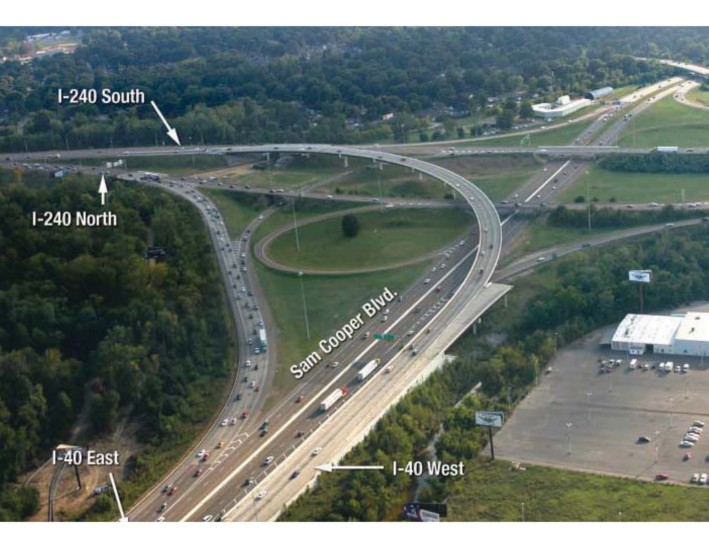
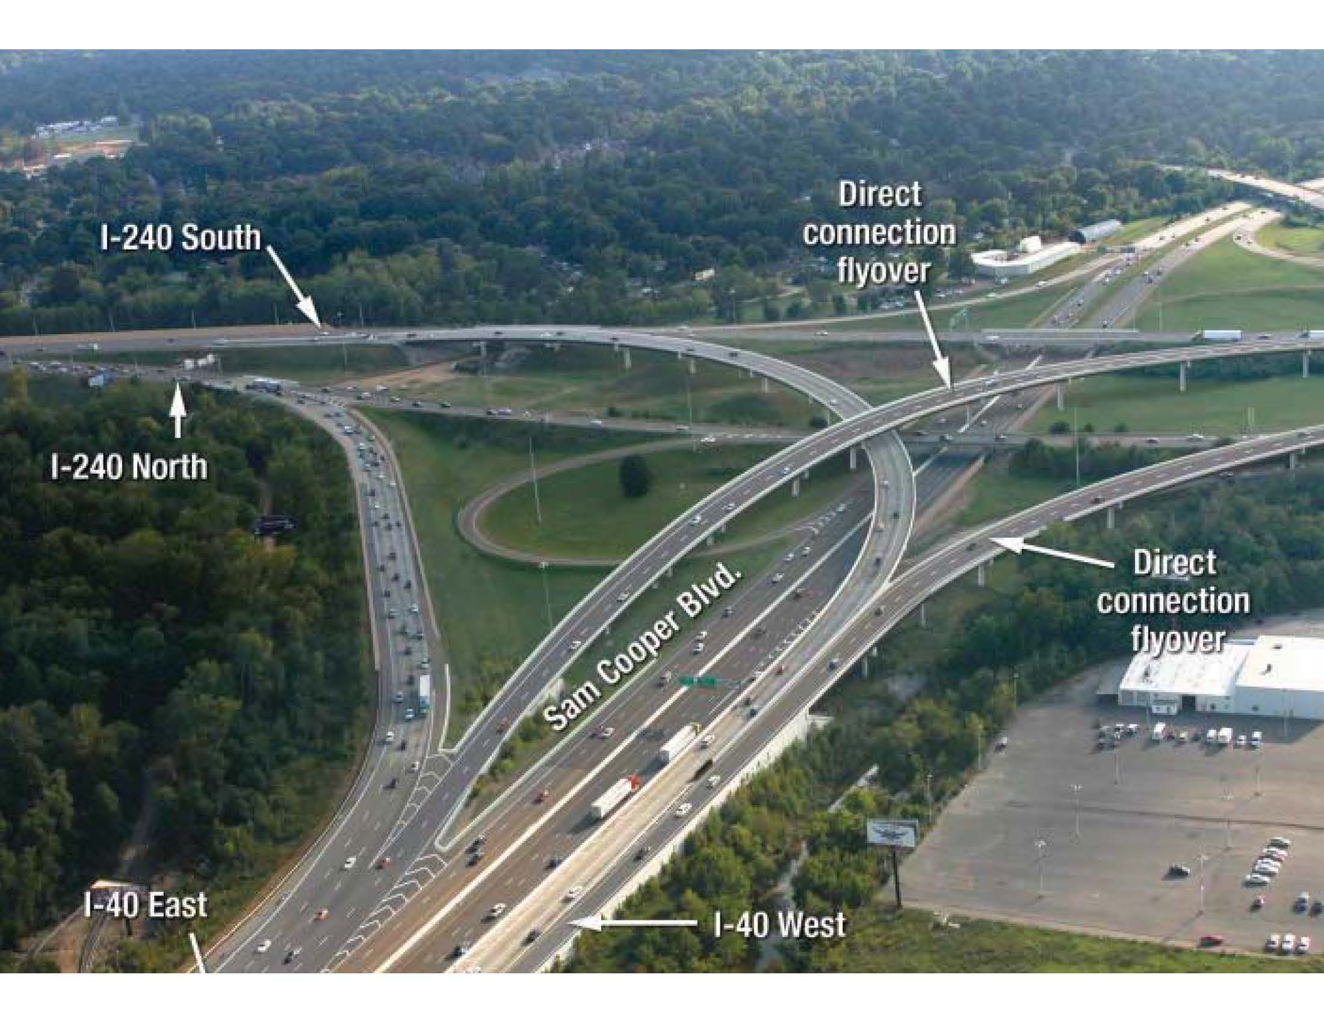
I-40/I-240 EAST INTERCHANGE

Slide 4
PROJECT SUMMARY
Busiest intersection in TN (more than 200,000 vehicles currently, over 350,000 vehicles by 2035)
Largest project contract awarded by TDOT (~$110M) at the time
Design is accordance with 2012 AASHTO LRFD
Six bridges: 2 new direct flyovers, Improvement of 4 existing bridges
23 retaining walls
Noise walls
More than 100,000 feet of piles
Construction period: 42 months

Slide 5
GEOTECHNICAL SUBSURFACE EXPLORATION
Started in 1999
Completed in 2013
  340 SPT borings
  Conventional sampling & testing
  Supplemental Cone Penetration Testing (CPT)
Two site-specific seismic studies

Slide 6
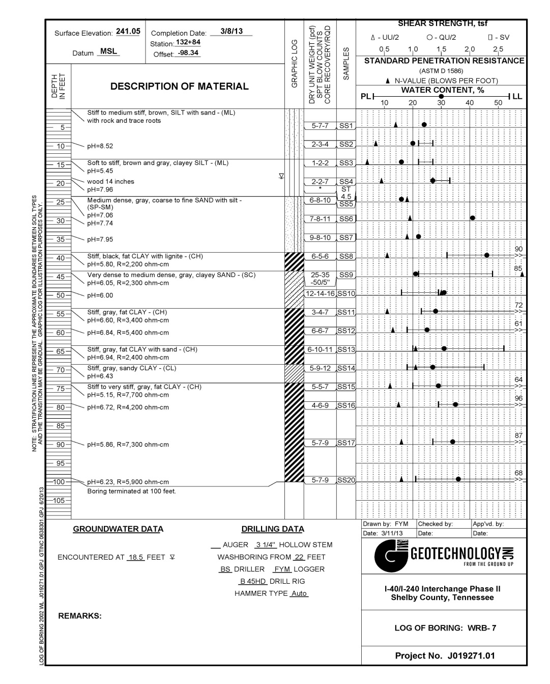
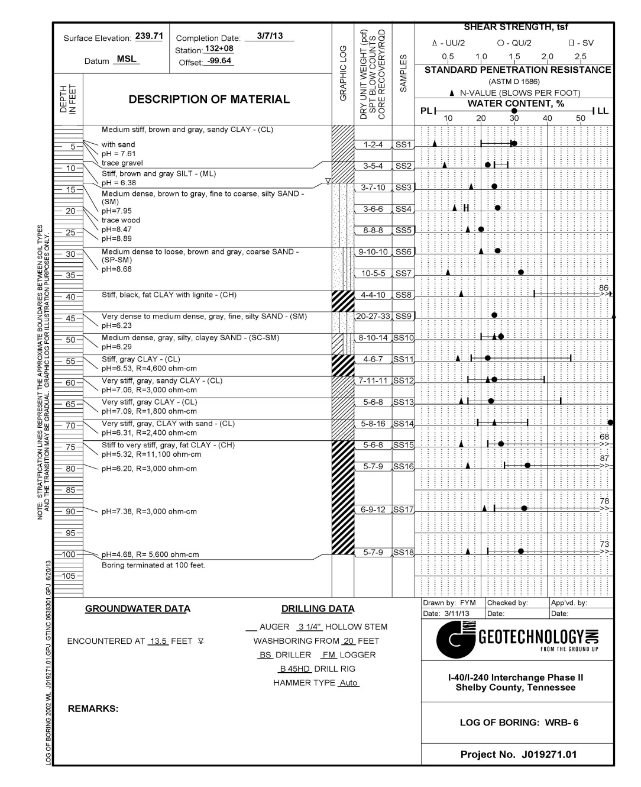
GENERAL SUBSURFACE CONDITIONS

Slide 7
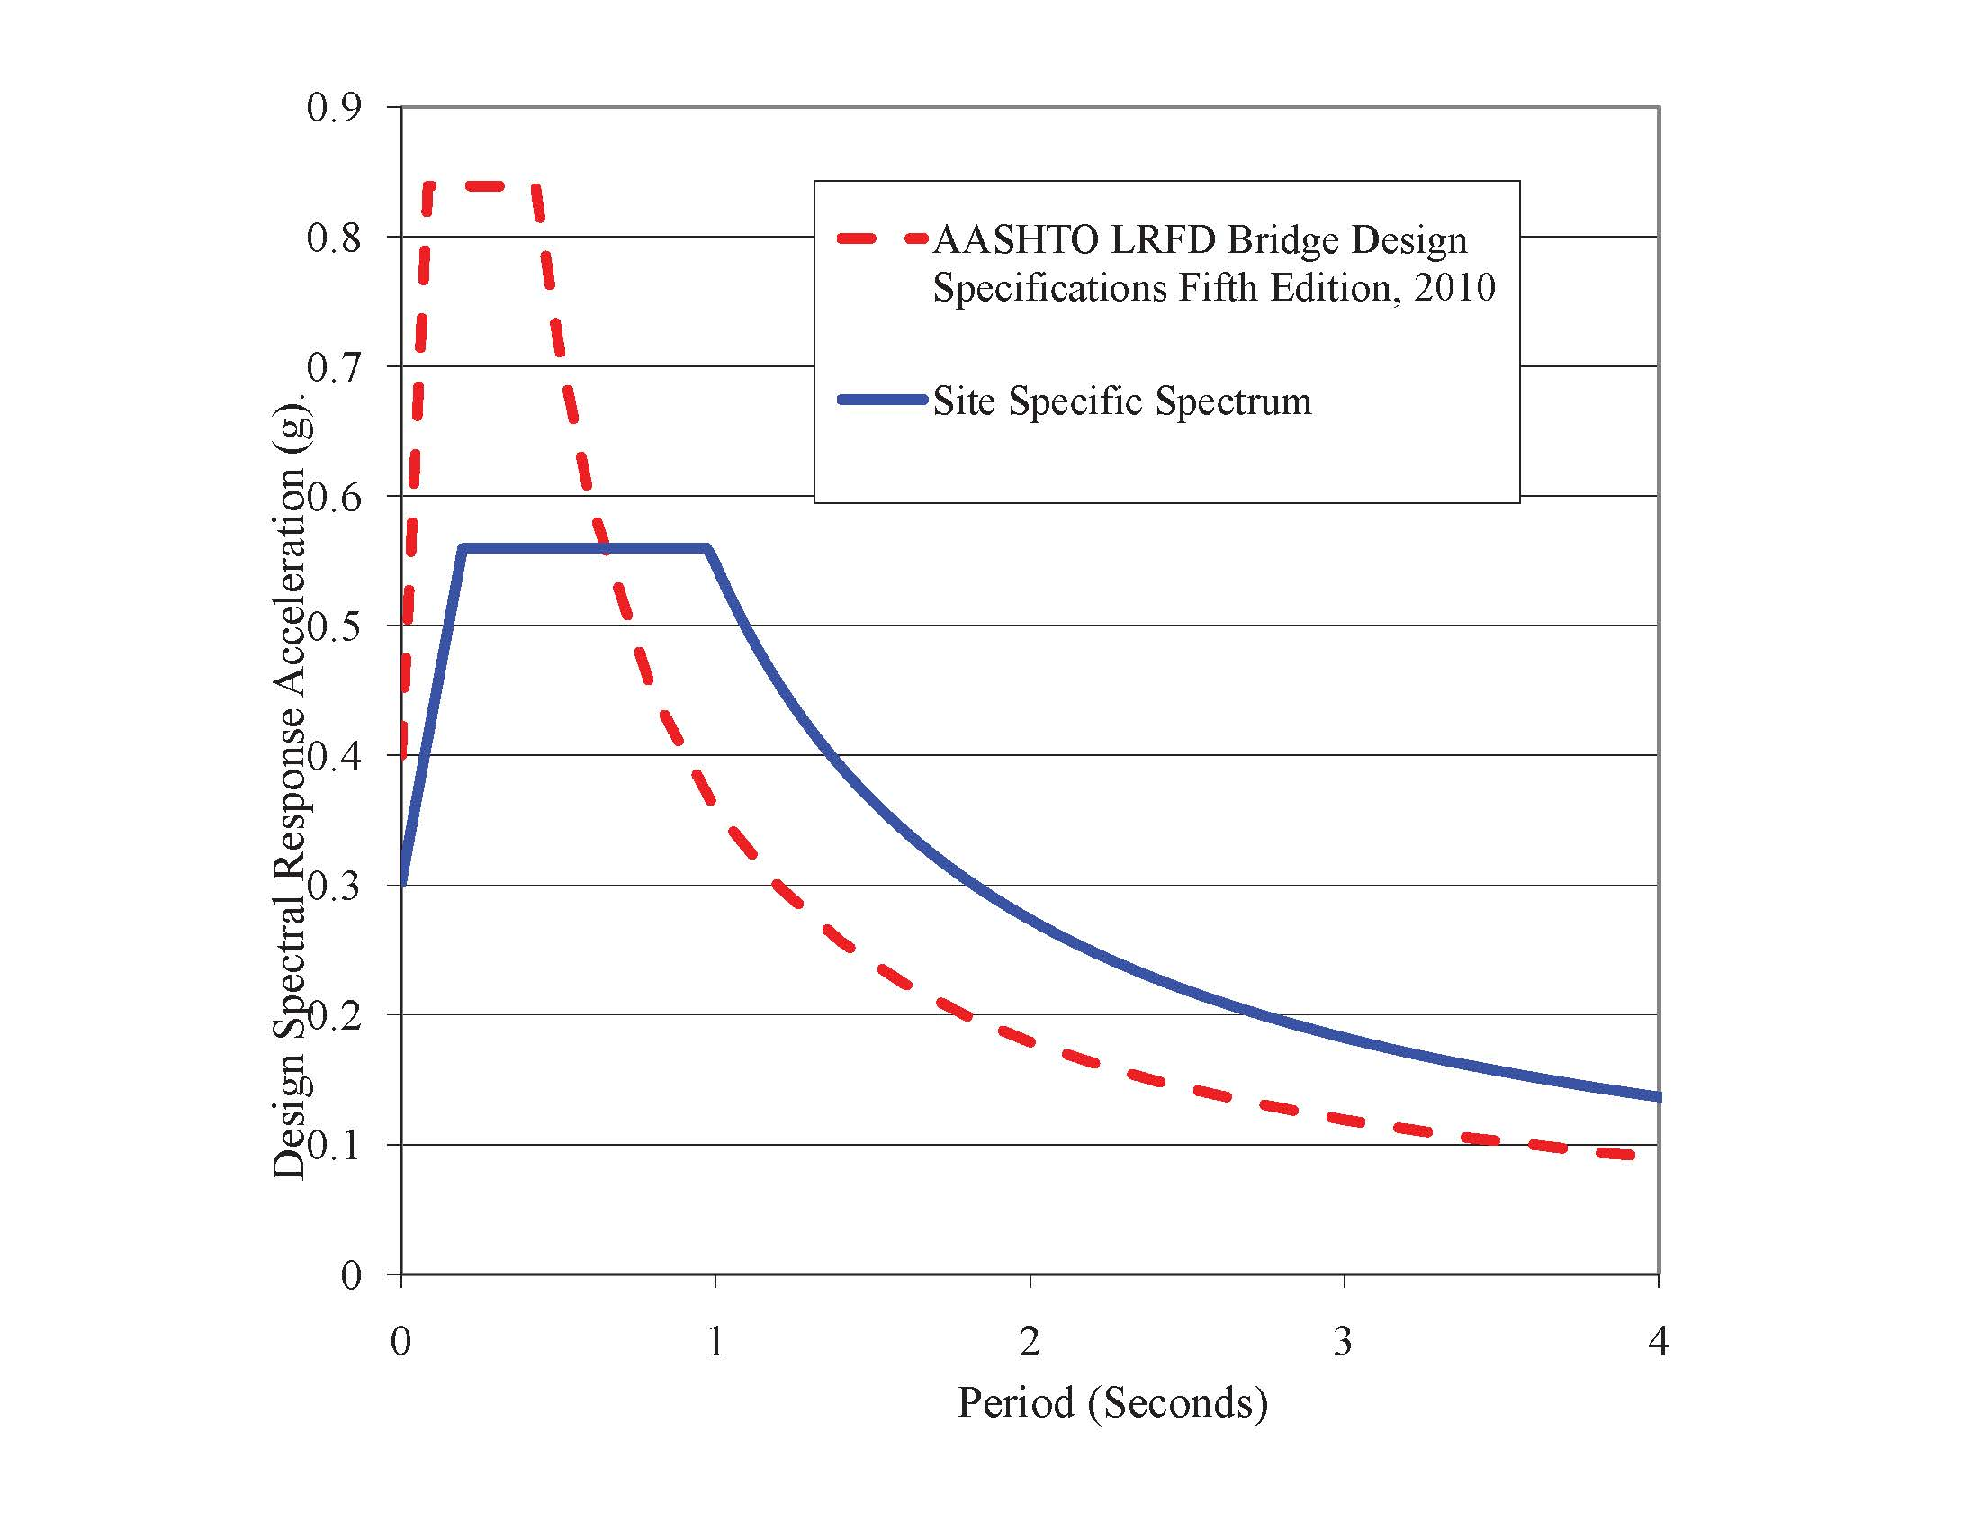
SITE-SPECIFIC SEISMIC STUDY

Slide 8
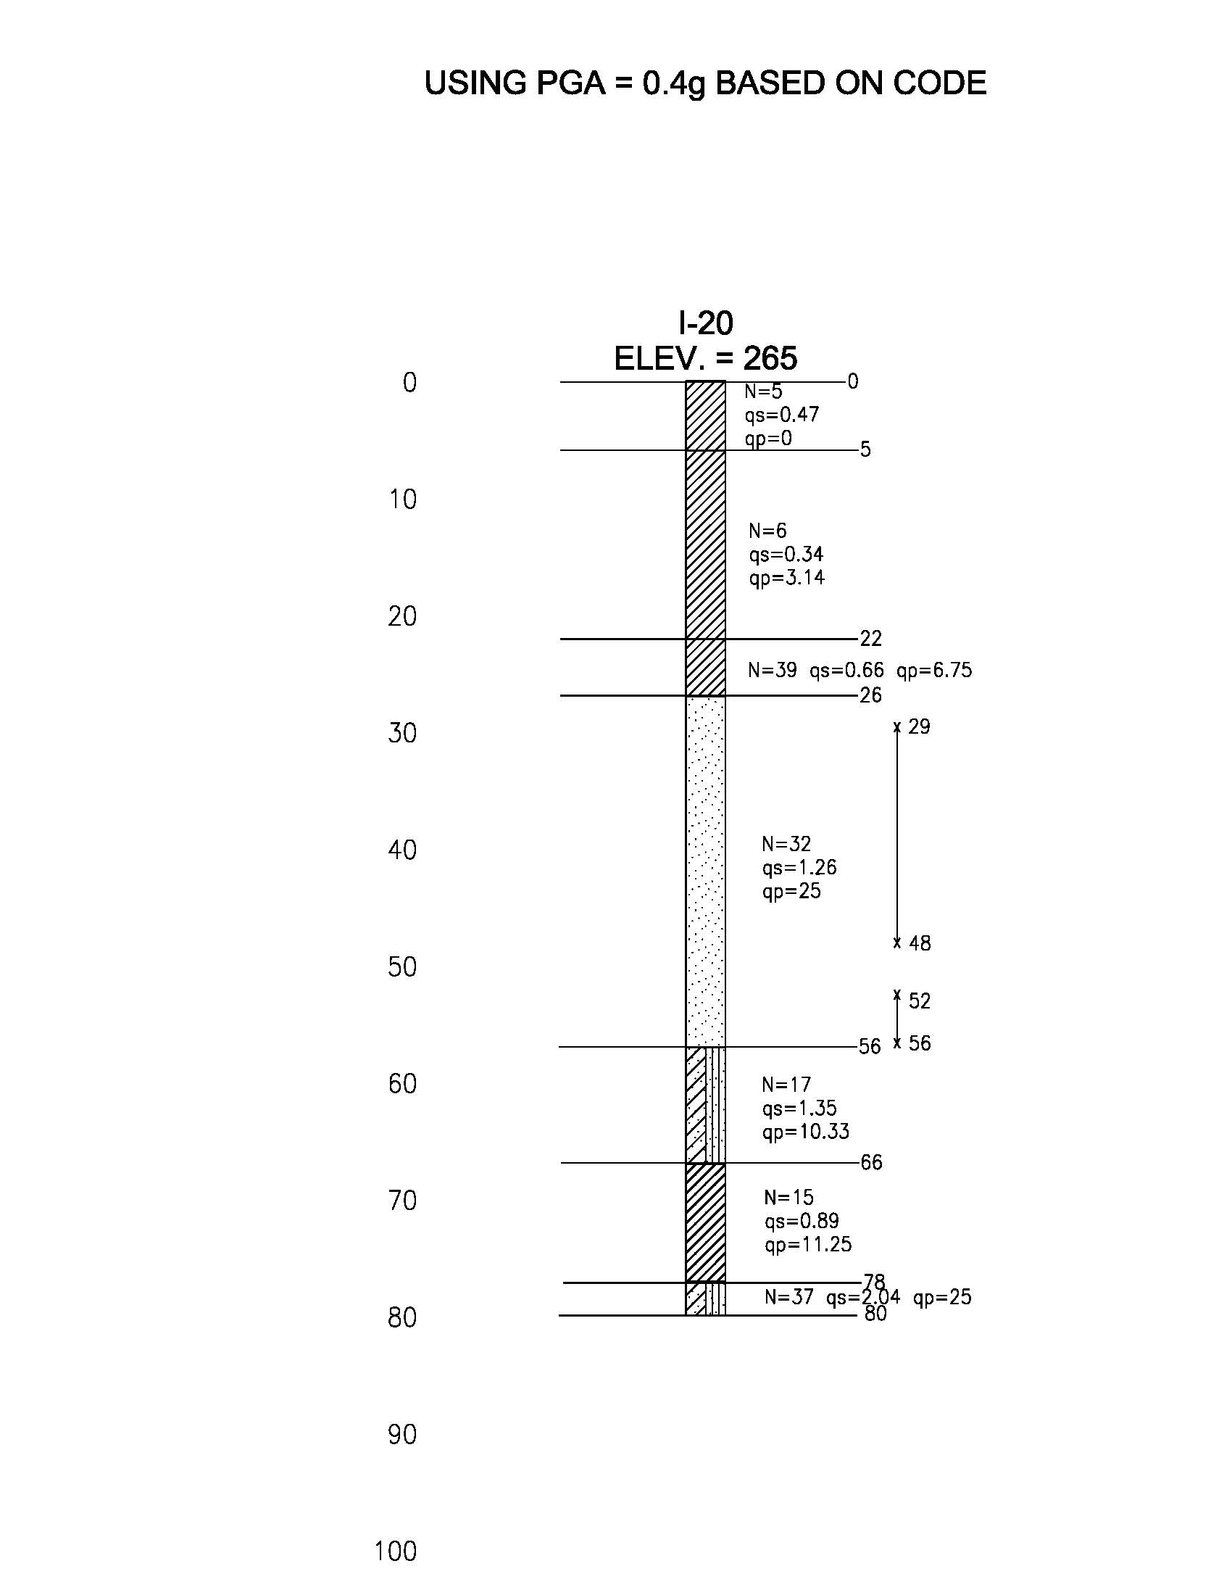
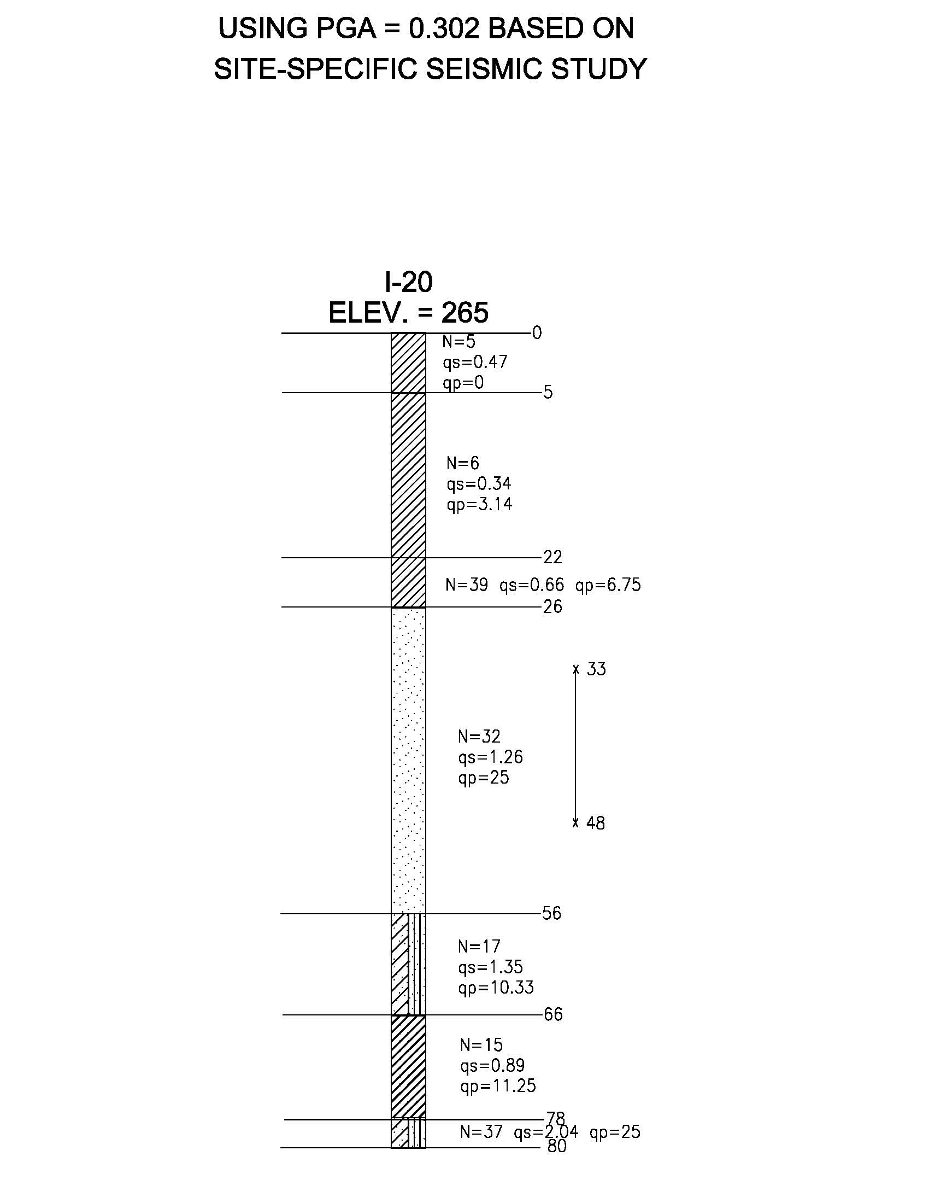
BENEFIT OF SITE-SPECIFIC STUDY
I-40/I-240 Interchange Bridge1, Memphis, TN
Pile Tip El. 209.5
Pile Tip El. 215.5

Slide 9
PILE DYNAMICS
Pile resistance has been typically evaluated by performing static load tests
Installation blow counts of driven piles have been used as a QC tool
The Engineering News (EN) formula has been used to assess the capacity (FoS = 6.0)
TDOT decided to allow high-strain dynamic testing of piles as the sole method of resistance evaluation

Slide 10
PILE DYNAMICS cont.
A resistance factor of 0.65 in the design (dynamic testing of at least two production piles per site condition, but no less than 2% of the production piles)
Testing was performed on production piles during initial driving and 7-day restrike
The nominal axial resistances were then estimated using the CAse Pile Wave Analysis Program (CAPWAP)

Slide 11
TEST PILE INSTALLATION SUMMARY
Test No. | Bridge No. | Bent No. | Pile No. | Embed. (ft.) | Average of Bottom 5 feet |  | Average of Bottom One foot
 |  |  |  |  | Stroke (ft.) | Blow Count (blows/ft.) | Stroke (ft.) | Blow Count (blows/ft.)
1 | 1 | 3 | 71 | 29.0 | 7.60 | 60 | 8.50 | 64
2 |  | 5 |  | 37.0 | 7.80 | 112 | 7.80 | 117
3 |  | 7 | 64 | 28.0 | 7.70 | 69 | 7.60 | 75
4 |  | RW17 | 8 | 45.0 | 7.90 | 83 | 8.00 | 70
5 | 2 | RW19 | 23 | 49.0 | 7.70 | 74 | 7.70 | 79
6 |  | 2 | 1 | 34.0 | 7.80 | 87 | 8.00 | 98
7 |  | 4 | 1 | 19.0 | 7.50 | 116 | 7.80 | 118
8 |  | 5 | 64 | 23.0 | 8.70 | 53 | 9.00 | 52
9 |  | 7 | 64 | 37.0 | 9.00 | 59 | 9.00 | 62
10 |  | 9 | 1 | 30.0 | 7.90 | 141 | 8.30 | 117
11 |  | 11 | 72 | 30.0 | 5.90 | 67 | 6.60 | 150
12 |  | 12 | 8 | 14.5 | 6.60 | 33 | 7.10 | 41
13 |  | Abut. 2 | 1 | 31.0 | 5.60 | 155 | 5.70 | 201
14 | 4 | RW12 | 1 | 18.0 | 7.50 | 50 | 7.70 | 60

Slide 12
SUMMARY OF TEST RESULTS
Test No. | Static Resistance (kip) | End-of-Drive CAPWAP Resistance (kip) | Restrike Age (Days) | Restrike CAPWAP Resistance (kip)
 |  |  |  | Total | Side | Tip
1 | 371 | 290 | 7 | 337 | 303 | 34
2 | 612 | 409 | 8 | 545 | 521 | 24
3 | 420 | 393 | 7 | 399 | 297 | 102
4 | 826 | 335 | 7 | 788 | 742 | 46
5 | 660 | 306 | 7 | 630 | 574 | 56
6 | 410 | 330 | 8 | 345 | 219 | 126
7 | 400 | 379 | 7 | 393 | 100 | 293
8 | 425 | 397 | 7 | 415 | 226 | 189
9 | 328 | 258 | 7 | 274 | 196 | 78
10 | 450 | 397 | 7 | 439 | 93 | 346
11 | 400 | 327 | 7 | 344 | 277 | 67
12 | 238 | 222 | 5 | 227 | 78 | 149
13 | 304 | 253 | 7 | 272 | 64 | 208
14 | 403 | 305 | 7 | 356 | 117 | 239

Slide 13

OBJECTIVES
Can pile setup in western Tennessee be estimated with an acceptable accuracy?
Can one or more of the available pile driving formulae (i.e., dynamic formulae) be used to predict the long-term nominal axial resistance indicated by the dynamic testing results?
How should the terminal driving resistance be used for quality control?
Can we detect pile damage due to overstressing during driving?

Slide 14
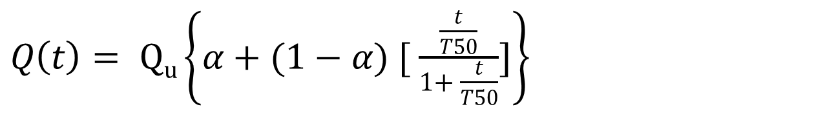
ESTIMATING SETUP
Modified Bogard & Matlock (B‑M) equation:
$Q\left(t\right)= Qu\left\{α+(1−α) [ \frac{\frac{t}{T50}}{1+ \frac{t}{T50}}]\right\}$
Q(t): the resistance at time t,
Q_{u}: the nominal resistance with 100% of setup realized
T₅₀: the time required to realize 50% of pile setup
α: empirical coefficient in the range of 0.2 to 0.5

Slide 15
SITE CORRELATION
T₅₀ was estimated to be 0.5 to 2 days, based on site conditions (low-plasticity clays, silts and sands)
An α value of 0.2 appears to be suitable when tip resistance is less than 40 percent of the total resistance
When tip resistance is more than 40 percent of the total resistance, an α value of 0.5 appears to be suitable

Slide 16
RESULTS
Bridge 1 Bent 3 (Test 1) α = 0.2 & 0.5

Slide 17
RESULTS cont.
Bridge 2 Abutment 2 (Test 13) α = 0.2 & 0.5

Slide 18
PILE DRIVING FORMULA
Three formula:
Engineering News (EN)
Modified Gates (MG)
Washington DOT (WSDOT)

Slide 19
FORMULA COMPARISON
Test No. | Eng. News (EN) kips |  | Modified Gates (MG) kips |  | WSDOT kips
 | 5 feet | 1 foot | 5 feet | 1 foot | 5 feet | 1 foot
1 | 1221 | 1424 | 420 | 460 | 286 | 326
2 | 1814 | 1855 | 511 | 517 | 341 | 344
3 | 1354 | 1408 | 443 | 450 | 301 | 303
4 | 1556 | 1420 | 475 | 455 | 322 | 313
5 | 1415 | 1473 | 452 | 461 | 306 | 311
6 | 1579 | 1733 | 477 | 501 | 322 | 339
7 | 1776 | 1863 | 504 | 518 | 330 | 345
8 | 1284 | 1311 | 439 | 446 | 317 | 327
9 | 1429 | 1477 | 464 | 471 | 338 | 342
10 | 2056 | 1974 | 547 | 537 | 363 | 366
11 | 1018 | 1767 | 371 | 499 | 229 | 307
12 | 686 | 871 | 311 | 354 | 211 | 242
13 | 1521 | 1720 | 455 | 490 | 262 | 281
14 | 1063 | 1237 | 393 | 424 | 270 | 290

Slide 20
FORMULA EVALUATION
Test No. | EN |  | MG |  | WSDOT
 | Diff. kips | DR_{u1}/R_{u5} | Diff. kips | R_{u1}/R_{u5} | Diff. kips | R_{u1}/R_{u5}
1 | -204 | 1.17 | -39 | 1.09 | -39 | 1.14
2 | -41 | 1.02 | -6 | 1.01 | -3 | 1.01
3 | -54 | 1.04 | -8 | 1.02 | -2 | 1.01
4 | 136 | 0.91 | 20 | 0.96 | 9 | 0.97
5 | -58 | 1.04 | -9 | 1.02 | -5 | 1.02
6 | -153 | 1.1 | -24 | 1.05 | -18 | 1.05
7 | -87 | 1.05 | -14 | 1.03 | -14 | 1.04
8 | -27 | 1.02 | -7 | 1.01 | -9 | 1.03
9 | -48 | 1.03 | -7 | 1.02 | -4 | 1.01
10 | 82 | 0.96 | 10 | 0.98 | -3 | 1.01
11 | -748 | 1.73 | -127 | 1.34 | -78 | 1.34
12 | -185 | 1.27 | -43 | 1.14 | -31 | 1.15
13 | -199 | 1.13 | -35 | 1.08 | -19 | 1.07
14 | -174 | 1.16 | -31 | 1.08 | -21 | 1.08
Mean | -125.7 | 1.1 | -22.8 | 1.1 | -17.0 | 1.1
STDEV | 206.0 | 0.2 | 35.0 | 0.1 | 21.7 | 0.1
COV,% | -163.9 | 17.8 | -153.2 | 8.8 | -127.4 | 8.8

Slide 21
FORMULA COMPARISON cont.

Slide 22
CONCLUSIONS
The MG and WSDOT driving formulae are more accurate than the EN formula in estimating nominal static resistance in west Tennessee. The use of the EN formula should be discontinued.
The average driving data (blow count and hammer drop height) over the bottom 5 feet of driving is appropriate for friction piles in west Tennessee.
The average should be taken over the bottom one foot if a layer of very dense material is present at or above the pile tip elevations.
The Modified Bogard & Matlock equation can be used to provide a fairly accurate estimate of the CAPWAP restrike resistance in west Tennessee using the nominal long-term static resistance, α values of 0.2 to 0.5 and T₅₀ values of ½ to 2 days.

Slide 23
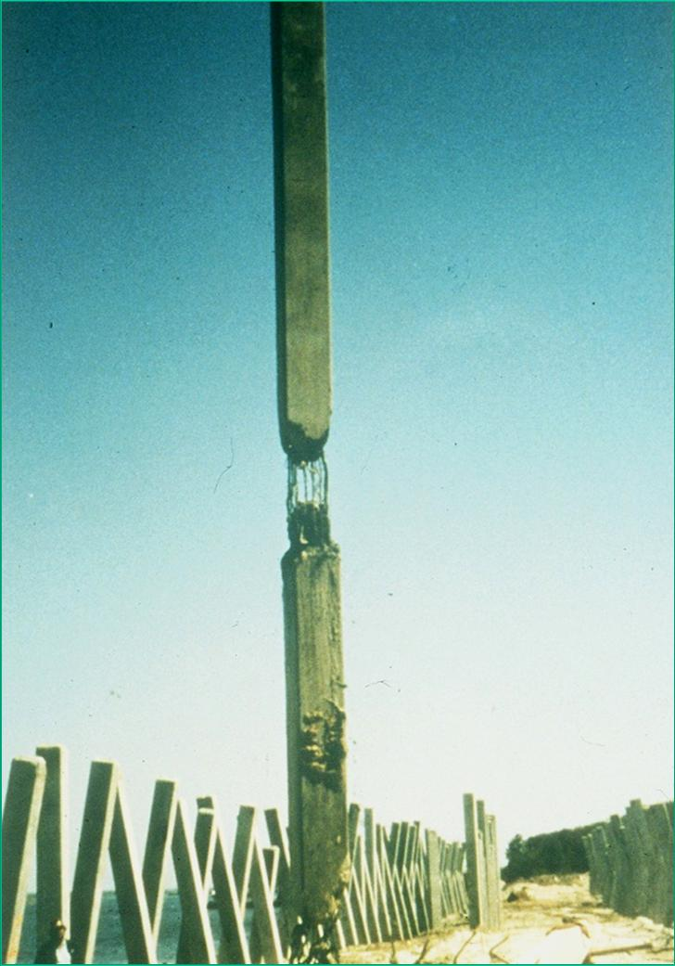
PILE INTEGRITY
F = Zv Z = Impedance = EA/c

Slide 24
PILE INTEGRITY-cont.
F = Zv Z = Impedance = EA/c
When Impedance changes, part of the downward traveling stress wave is reflected up and part continues to travel down
When the cross section of the pile is reduced, the up reflected stress wave is tensile, its magnitude indicates the extent of the cross section change

Slide 25
PILE INTEGRITY-cont.
PDA calculates a relative integrity factor (β)
When Impedance does not change, β = 1
GRL recommendations (2007):
  β > 0.8 ◊ slight damage
  β < 0.6 ◊ serious damage

Slide 26
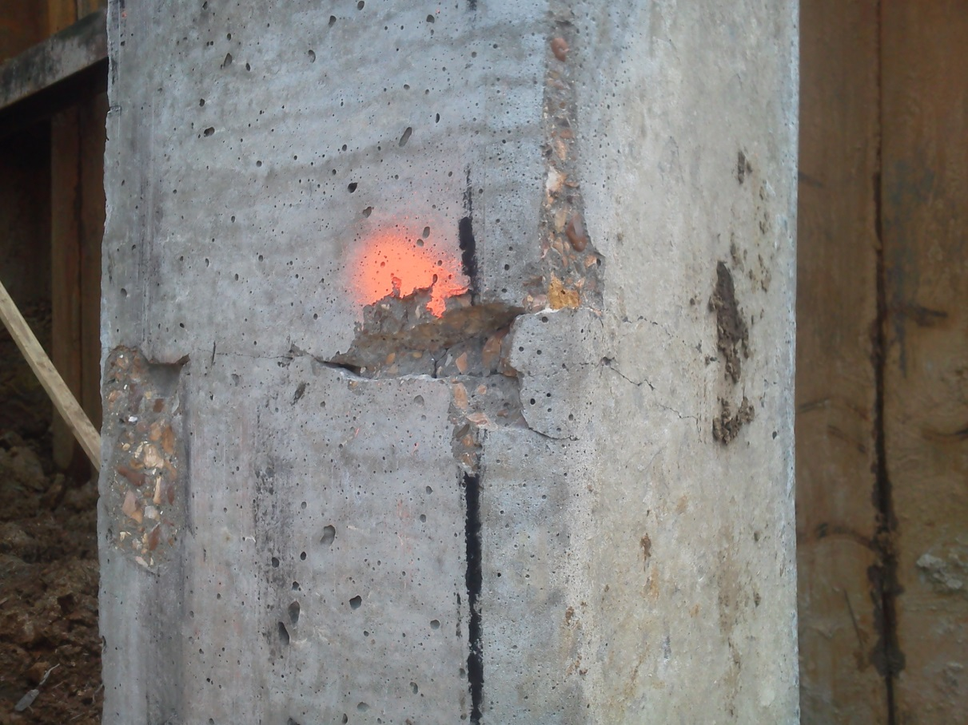
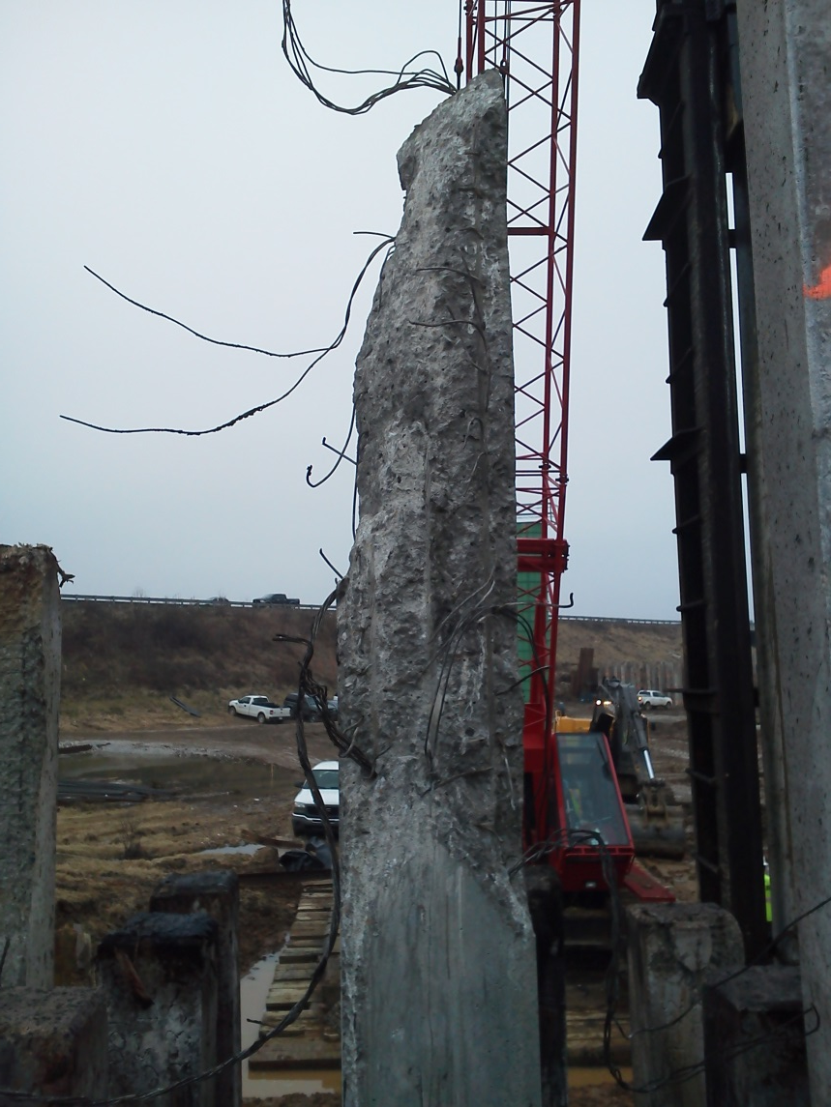
DETECTING DAMAGED PILES
HAMMER MALFUNCTION

Slide 27
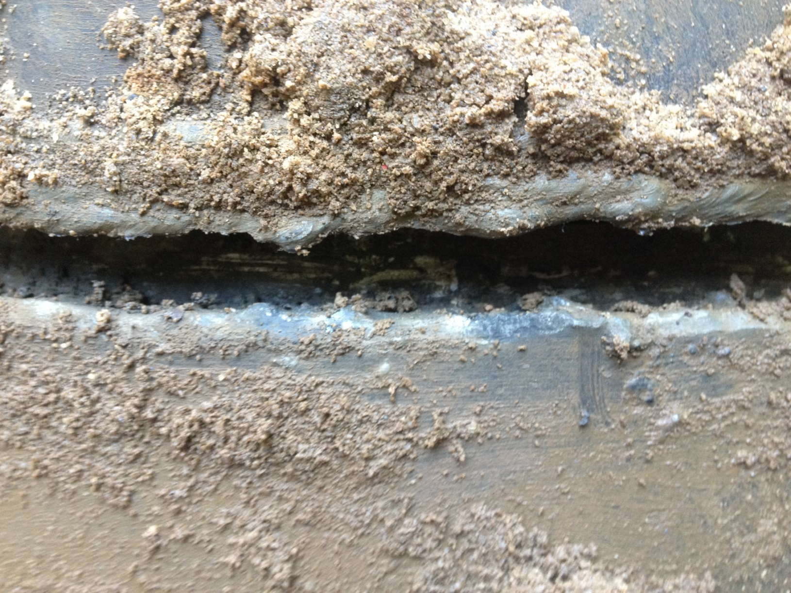
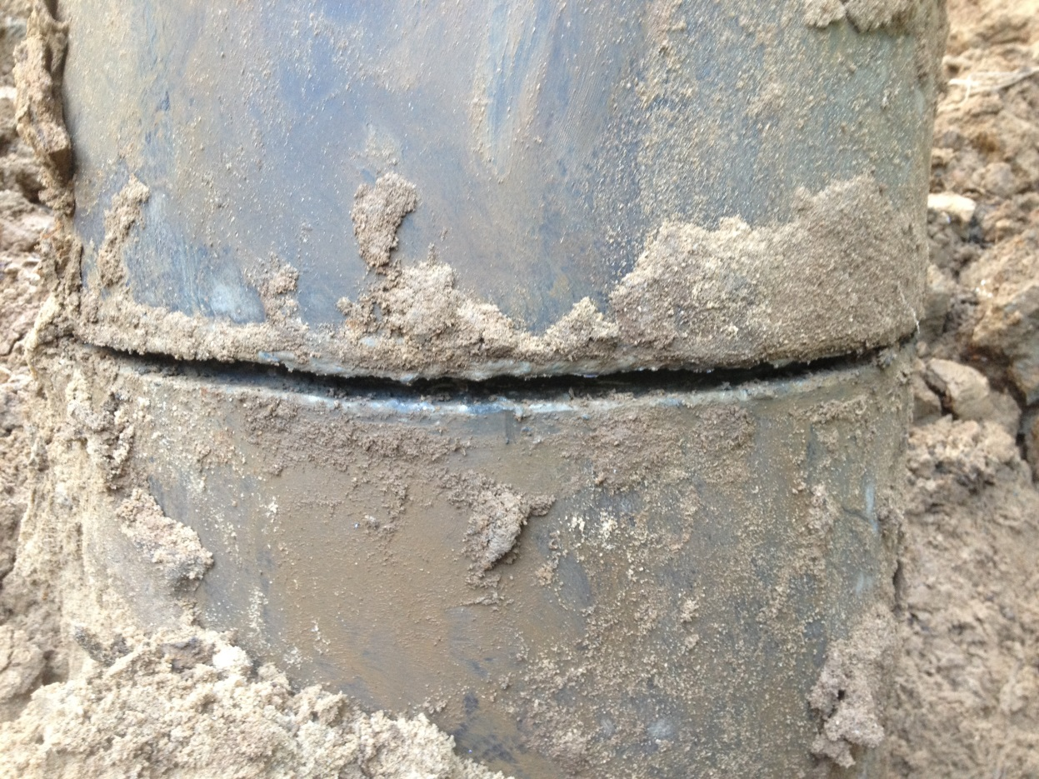
DETECTING DAMAGED PILES
POOR SPLICING

Slide 28
PILE EMBEDMENT
Piles are to penetrate through liquefiable soils into non-liquefying stratum
There were difficulties achieving the design tip elevations at some locations
Need to assess:
  Pile resistance
  Liquefiable zones
  Change in subsurface conditions due to pile driving
Need for reliable, quick subsurface information

Slide 29
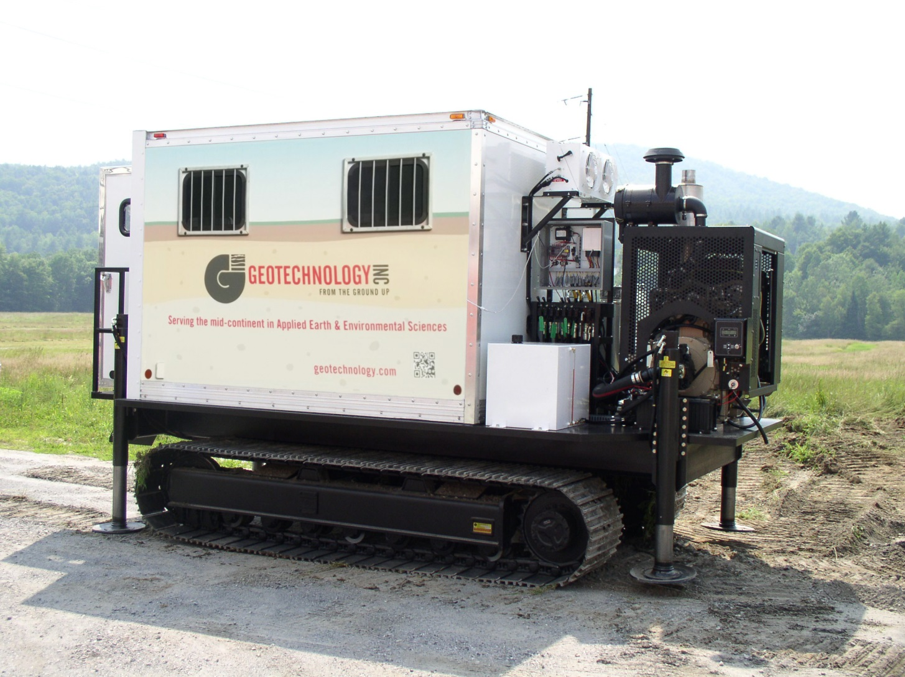
CPT

Slide 30
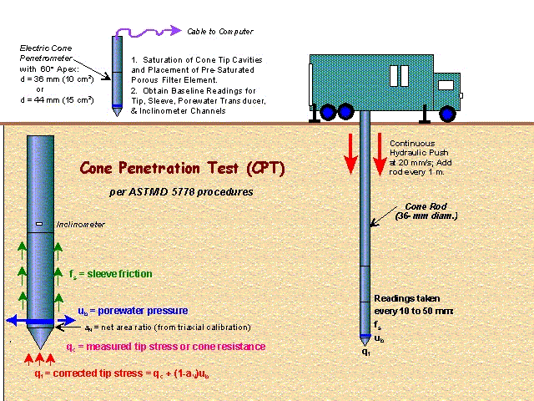
CPT

Slide 31
CPT

Slide 32
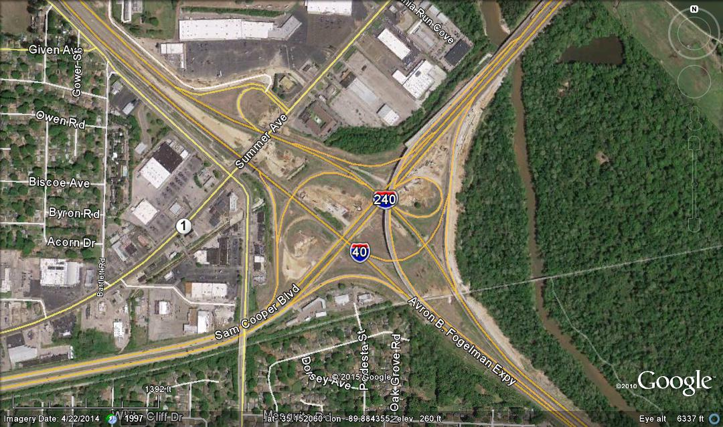
CPT AREAS OF STUDY
Notes:
This is an overhead view showing the site location along Summer Ave.

Slide 33
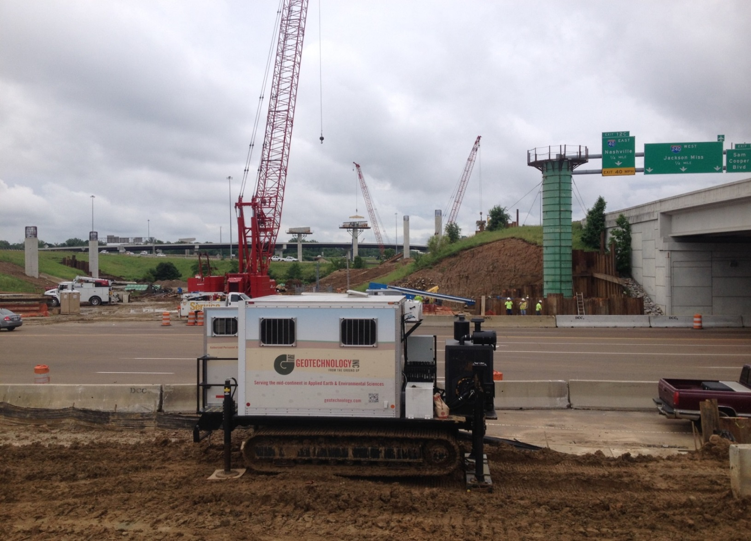
SUPPLEMENTAL LIQUEFACTION STUDY

Slide 34
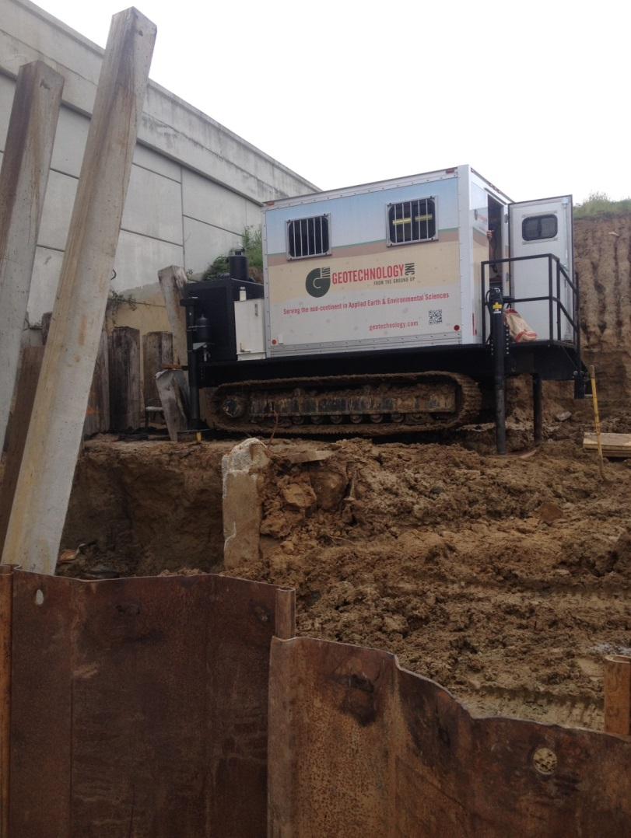
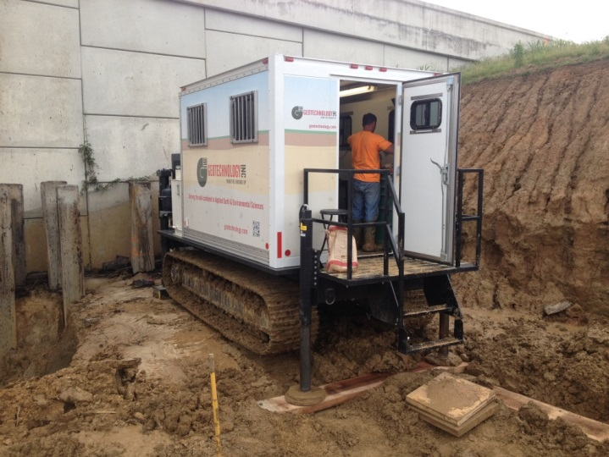
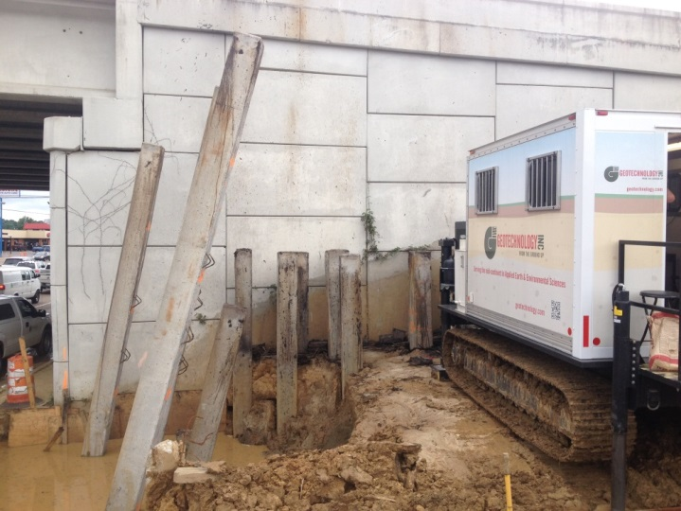
IMPACT OF PILE DRIVING

Slide 35
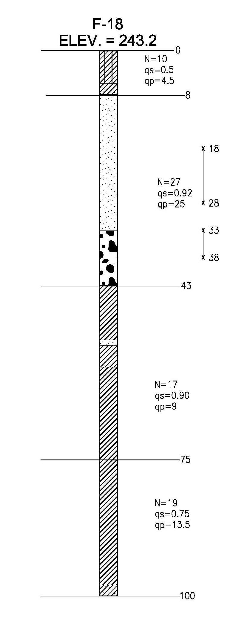
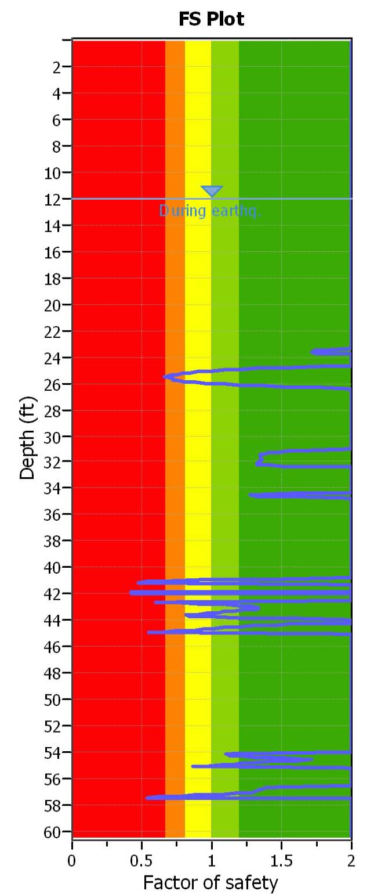
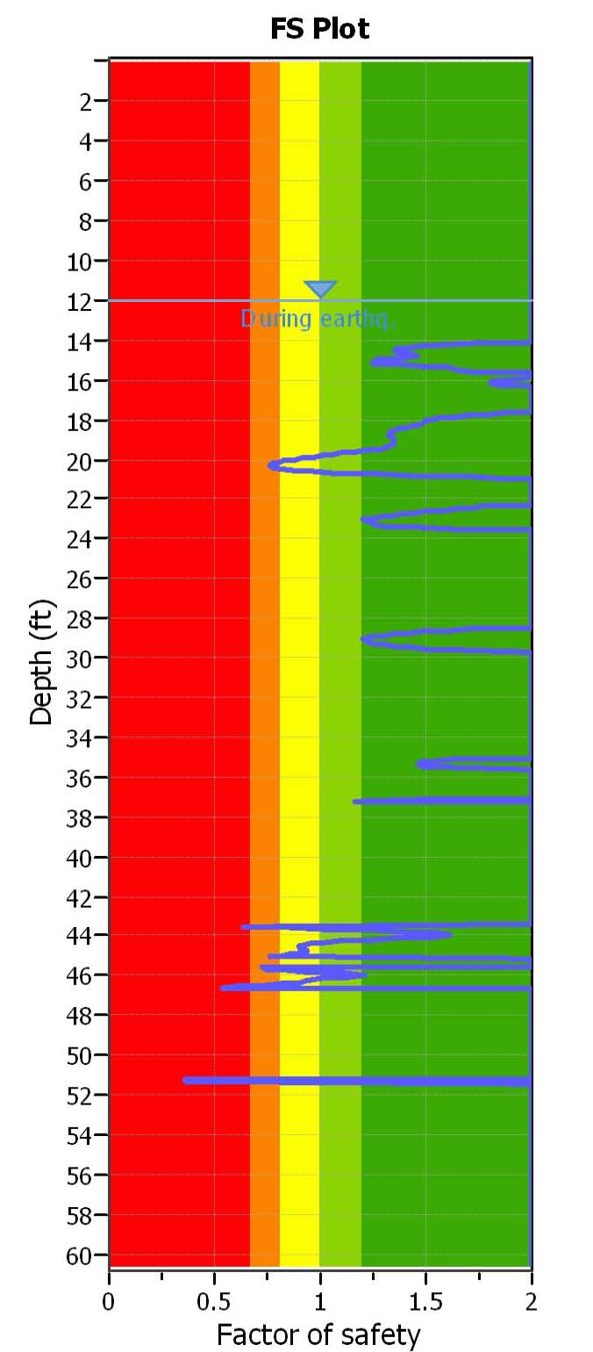
SUPPLEMENTAL LIQUEFACTION STUDY
CPT-3
I-40/240 Bridge 2, Bent 5
Liquefaction FOS Plot
Ground surface
CPT-4
Liquefaction FOS Plot
Bottom of cap
Liquefiable zone from SPT boring
Pile tip (new)
Liquefiable zone from SPT boring
Top of non-liquefiable zone
Pile tip (original)

Slide 36
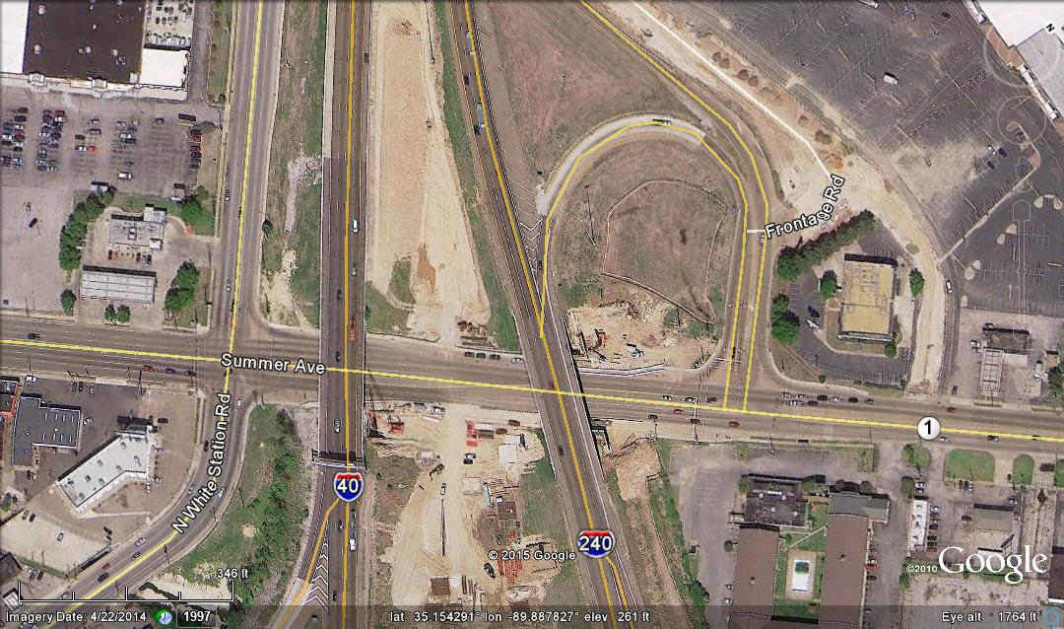
WALLS 17 AND 19
Wall 19
Wall 17

Slide 37
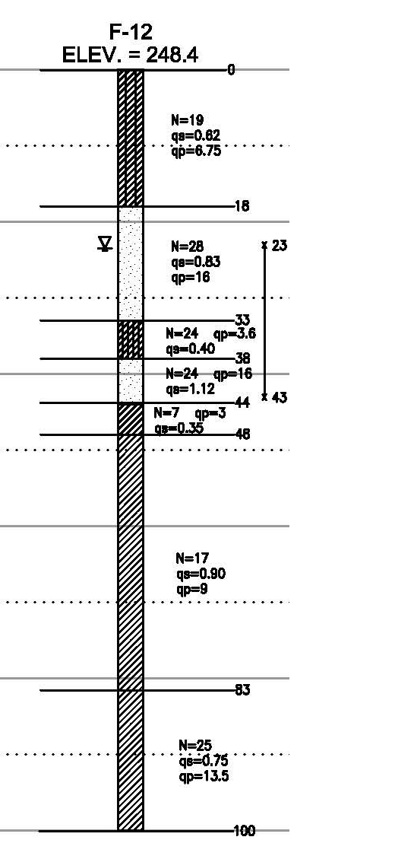
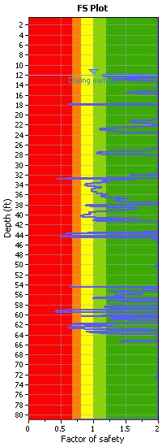
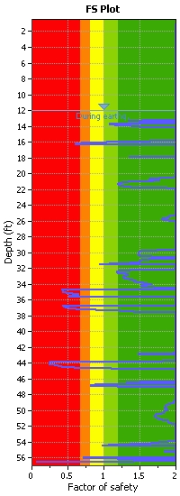
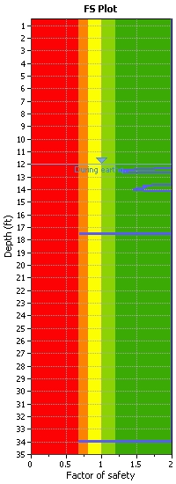
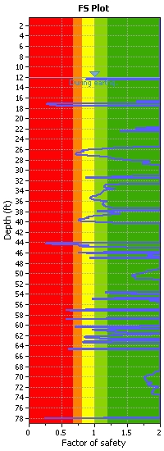
WALL NO. 19
CPT-7
CPT-4
Boring from ‘07
CPT-8
CPT-3
PILE CUTOFF EL. 243.89
Liquefiable zone
CONE REFUSAL @ 35 feet
PILE TIP EL. 211.00
(proposed)
MIN. PILE TIP El. 203.75
(per plans)
CONE REFUSAL @ 56 feet

Slide 38
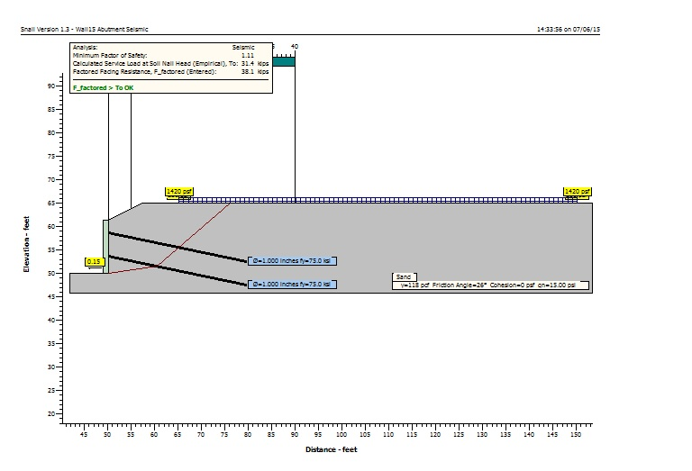
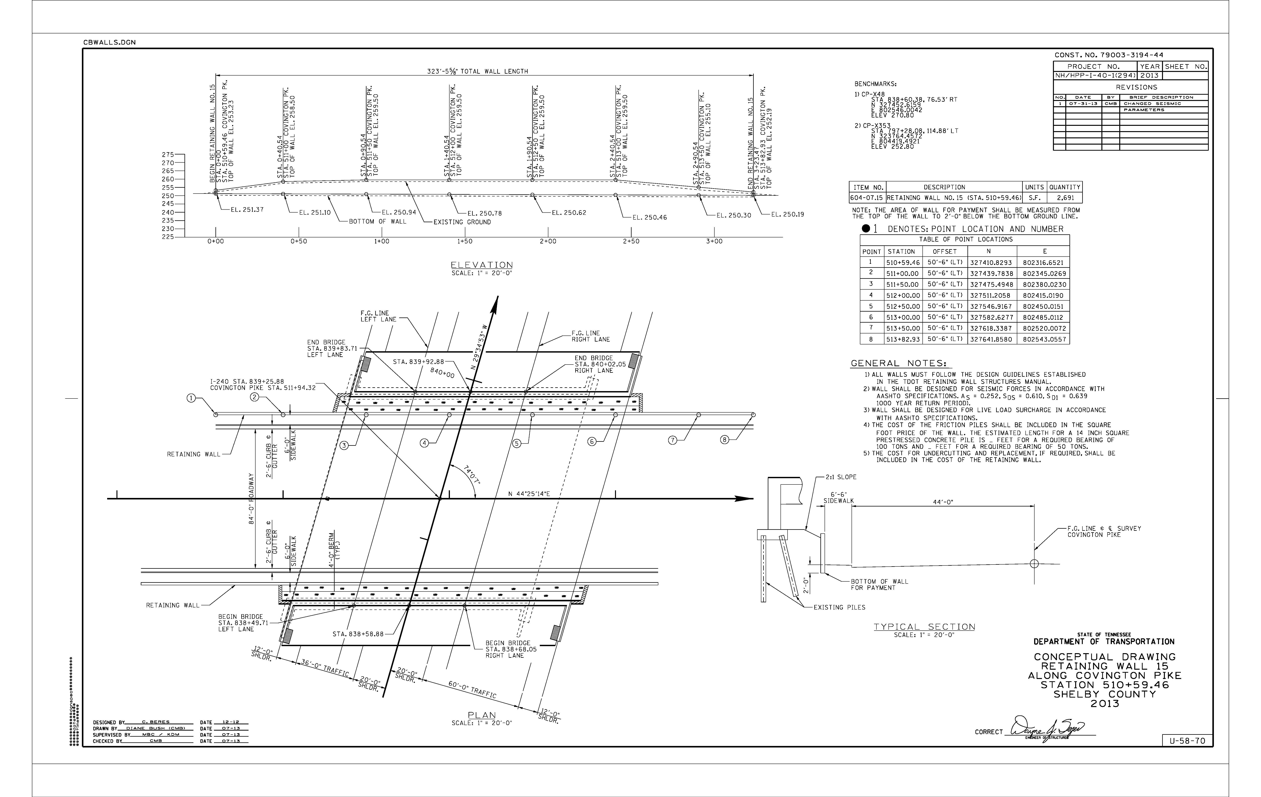
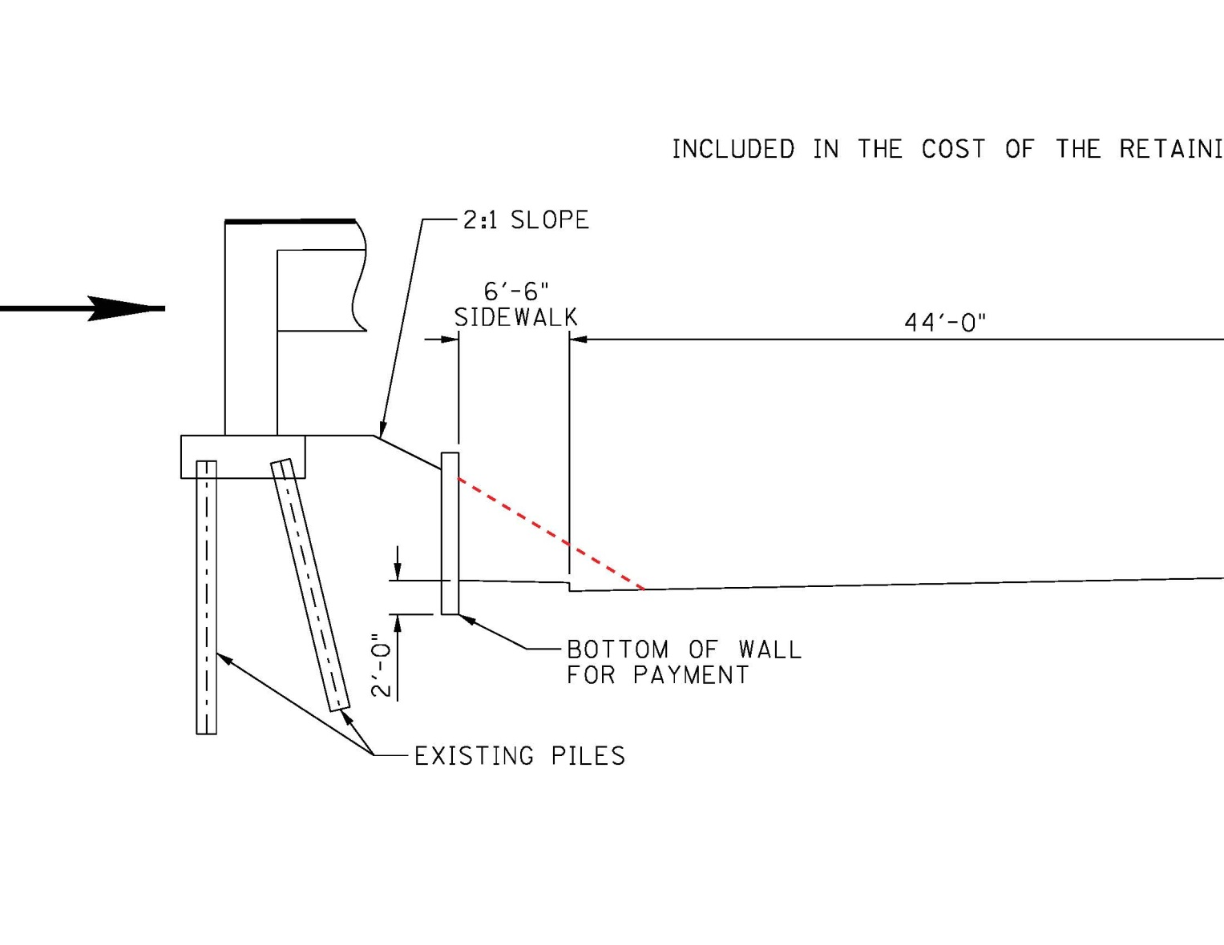
WALLS 15 &16

Slide 39
WALL 21
Problem: Insufficient factors of safety against global instability in seismic conditions
Solution: Ground improvement using rammed aggregate piers

Slide 40
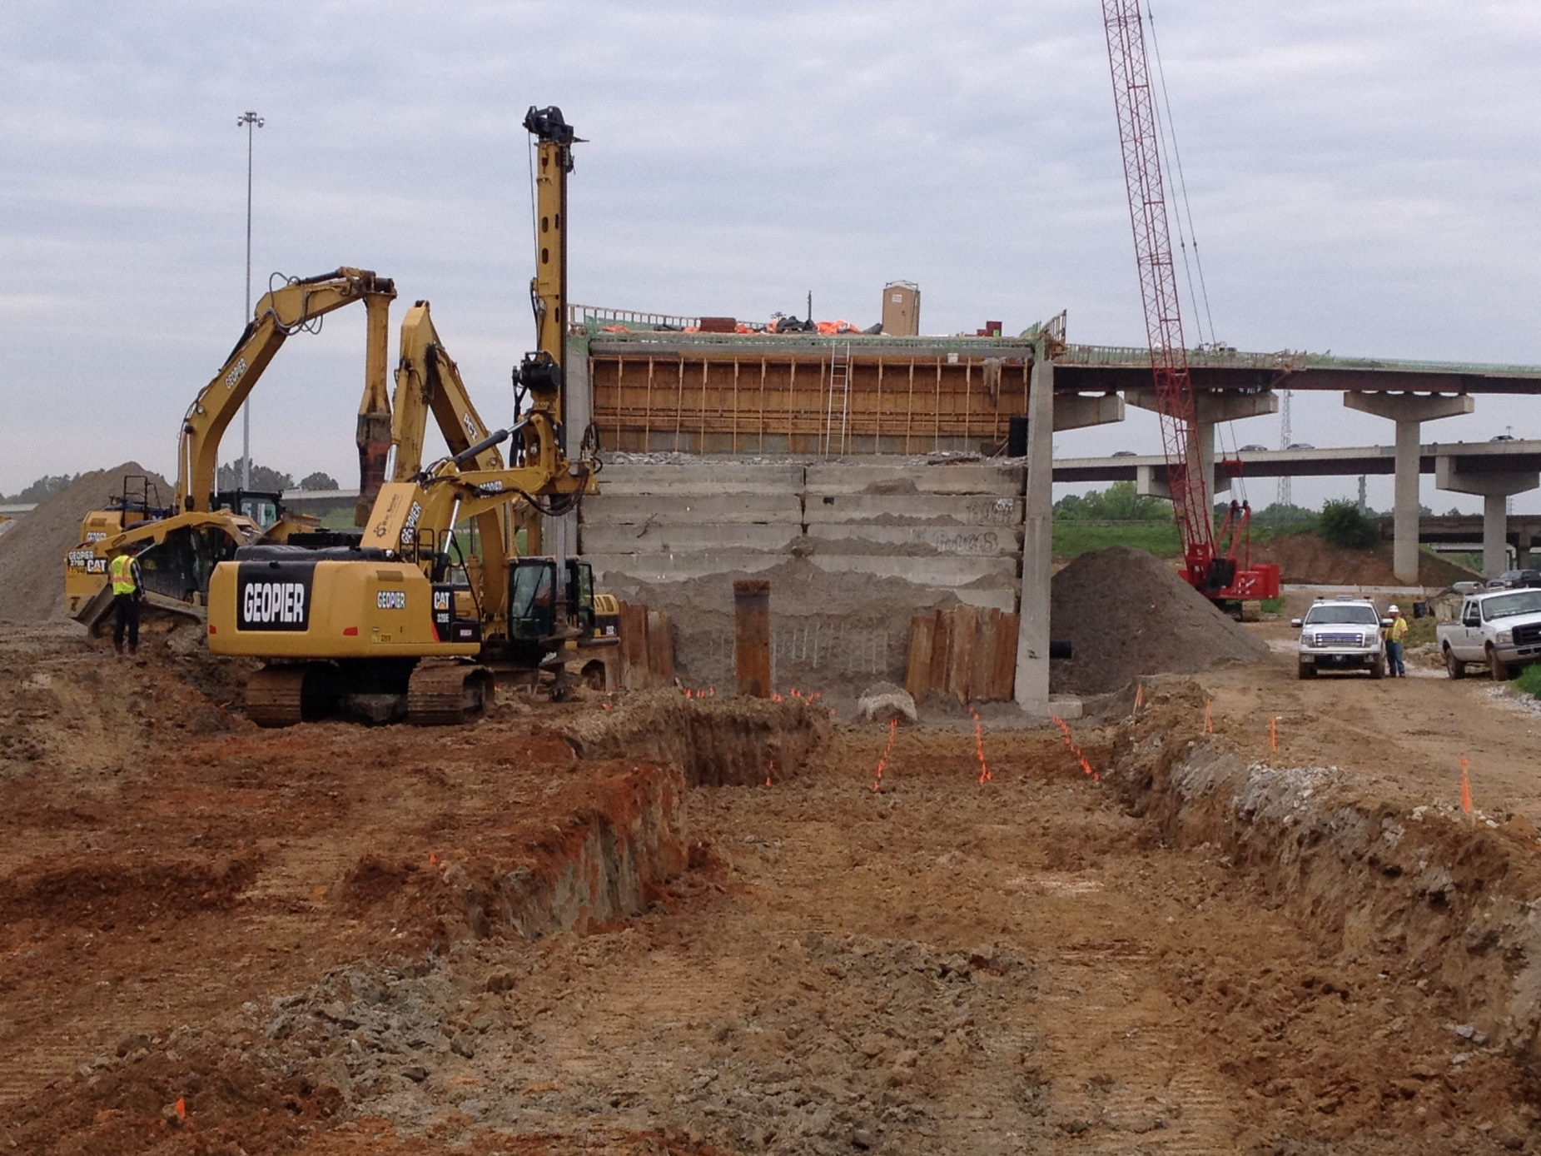
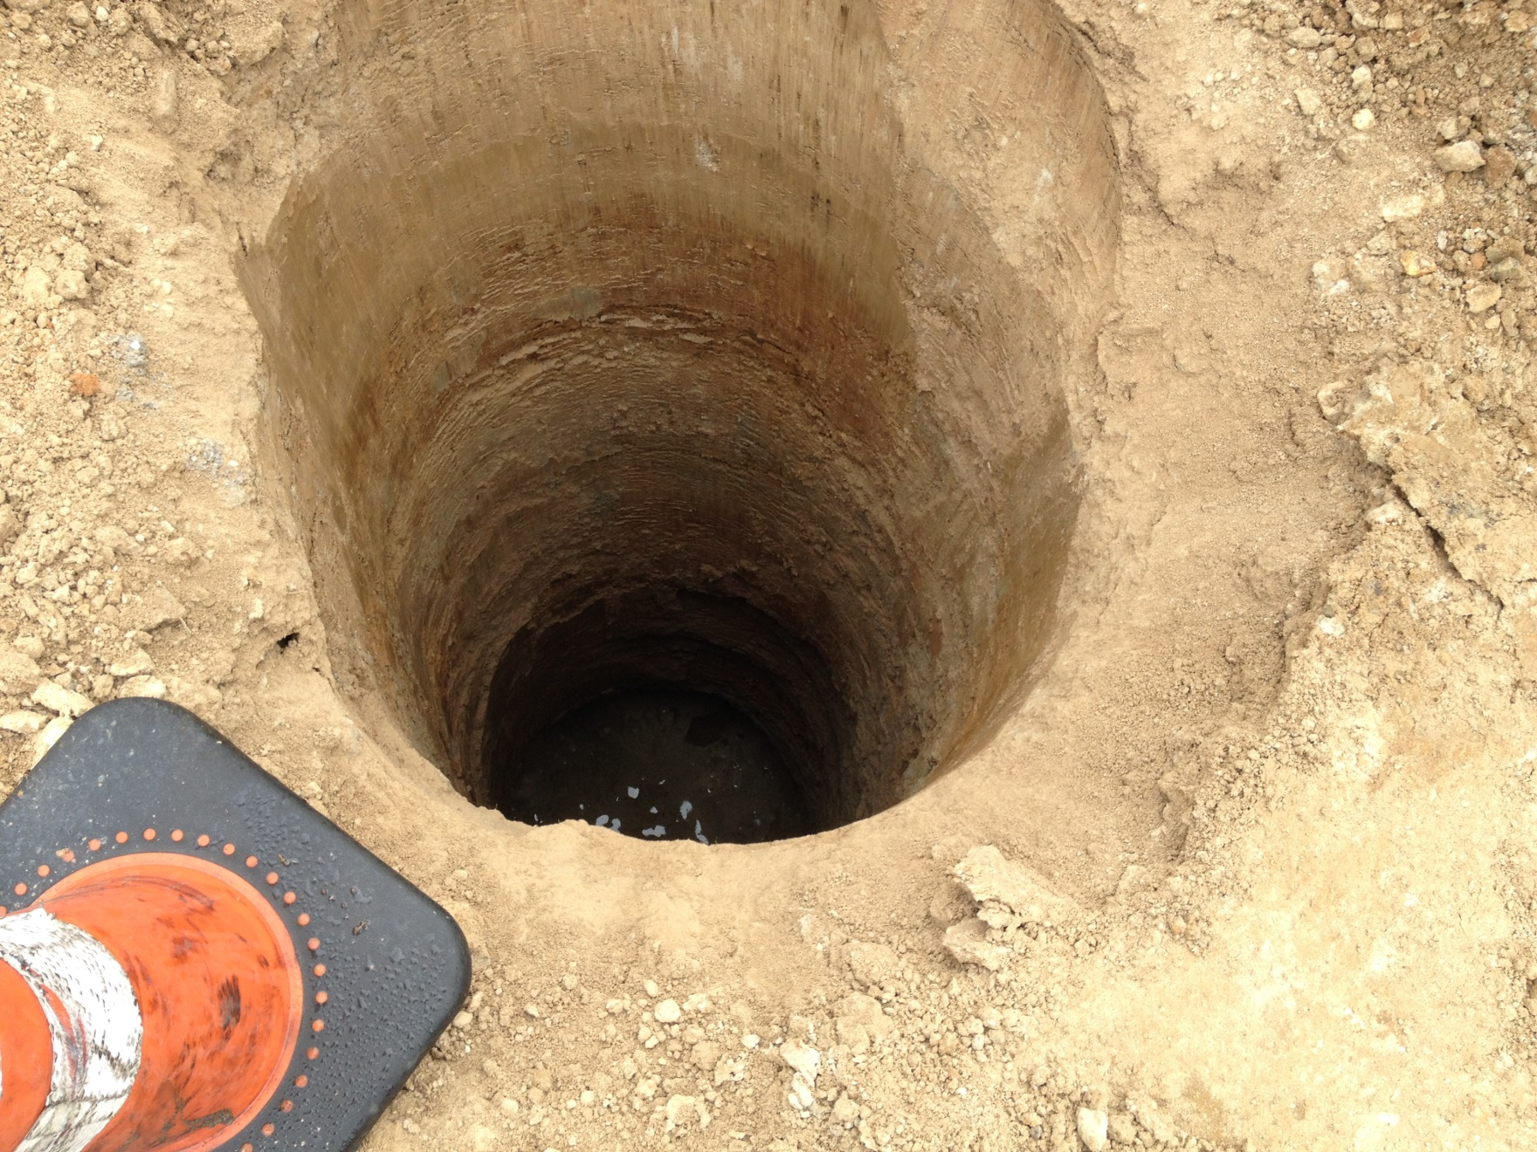
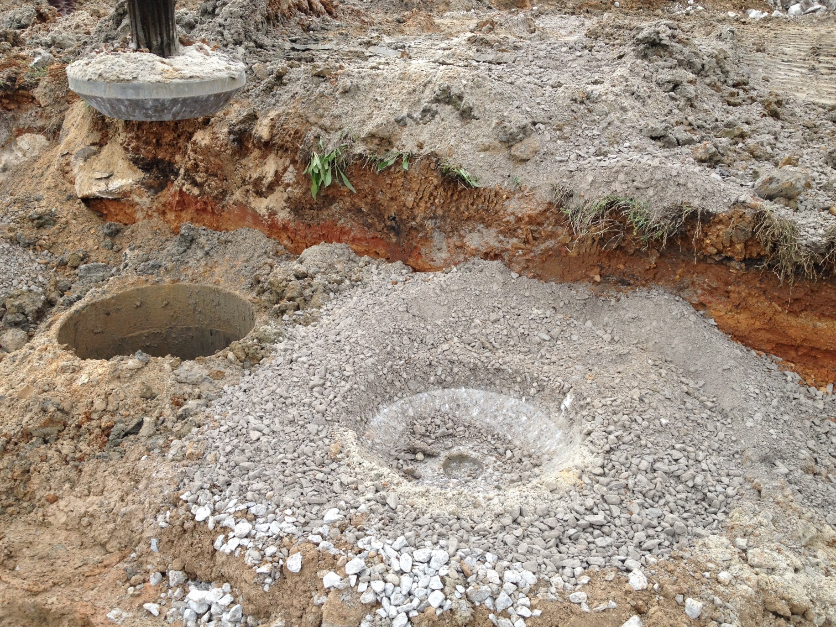
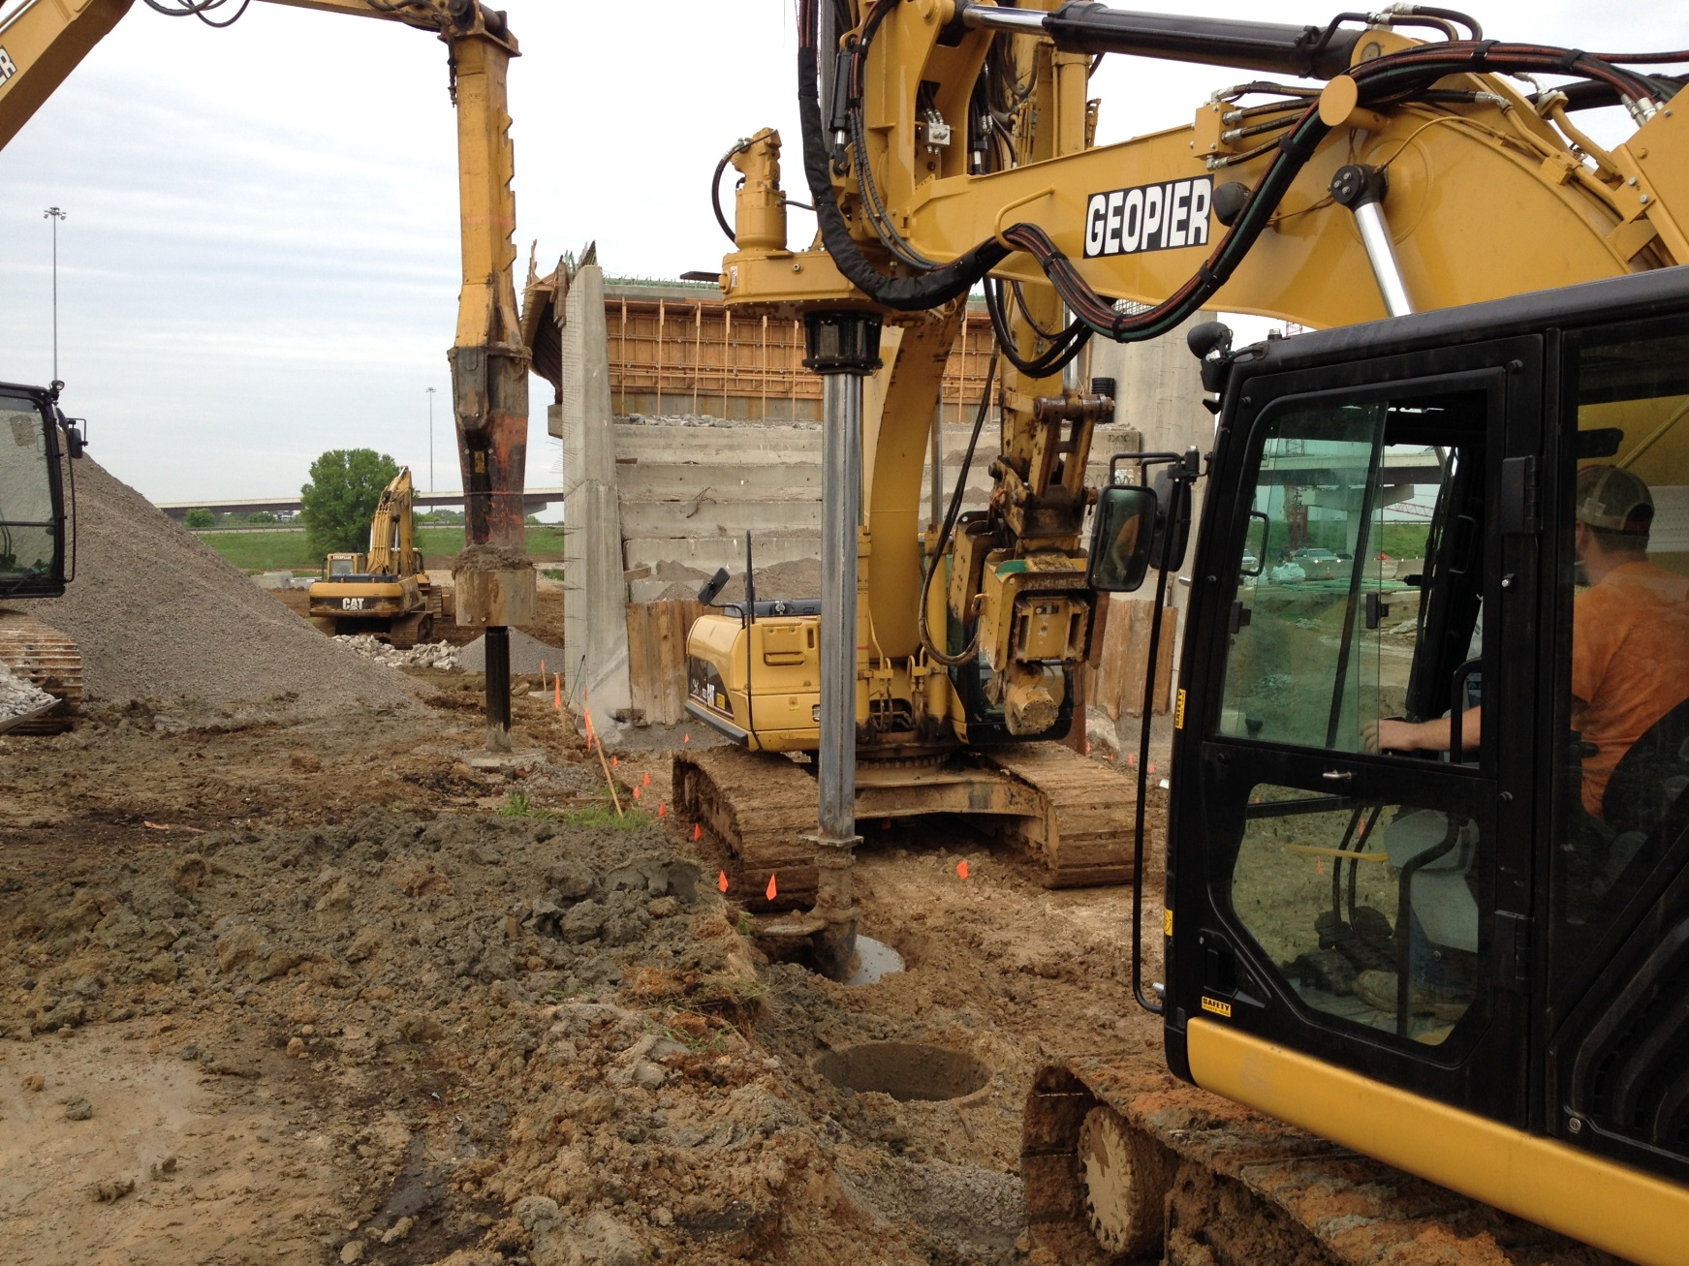
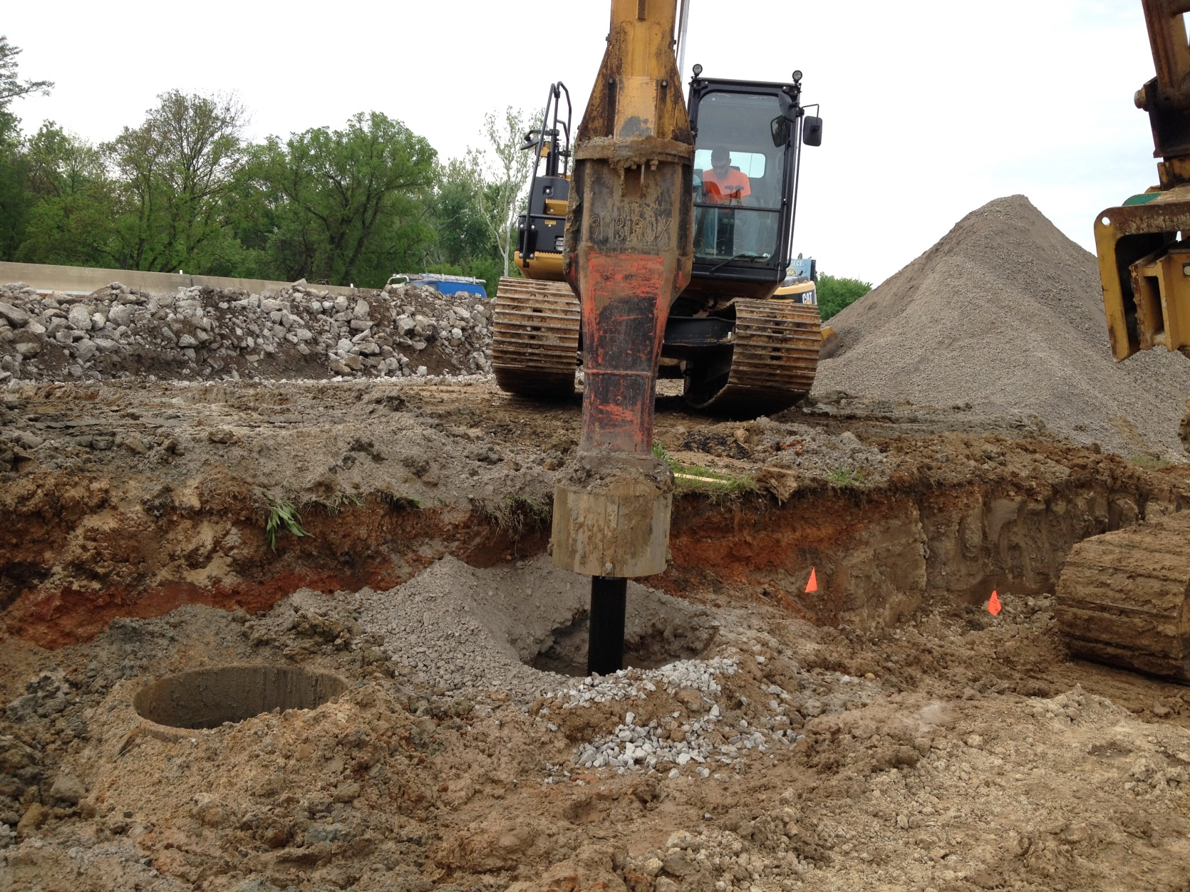
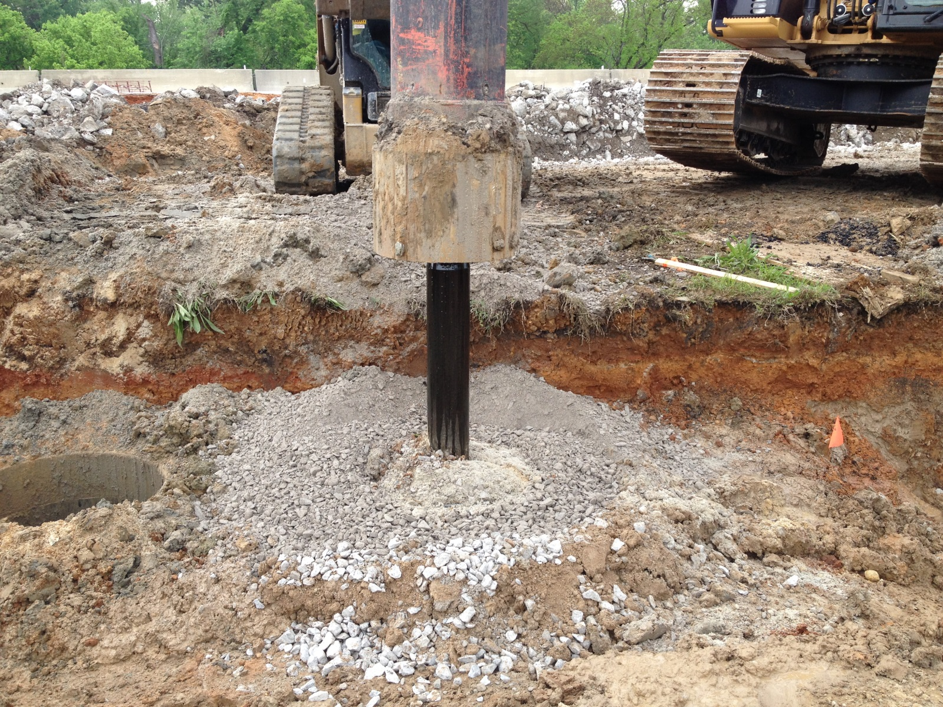
WALL 21

Slide 41
WALL 10
Needed to widen I-40 WB ramp
Two approved wall types
  Soldier Pile (embedded in drilled shafts) & Lagging Wall
  Pile-supported Cantilever Wall
TDOT set maximum deflection (6 inches for soldier pile wall and 2 inches for CIP wall)
To reduce lateral pressure, EPS foam blocks & light-weight flowable fill are to be used for backfill

Slide 42
WALL 10

Slide 43
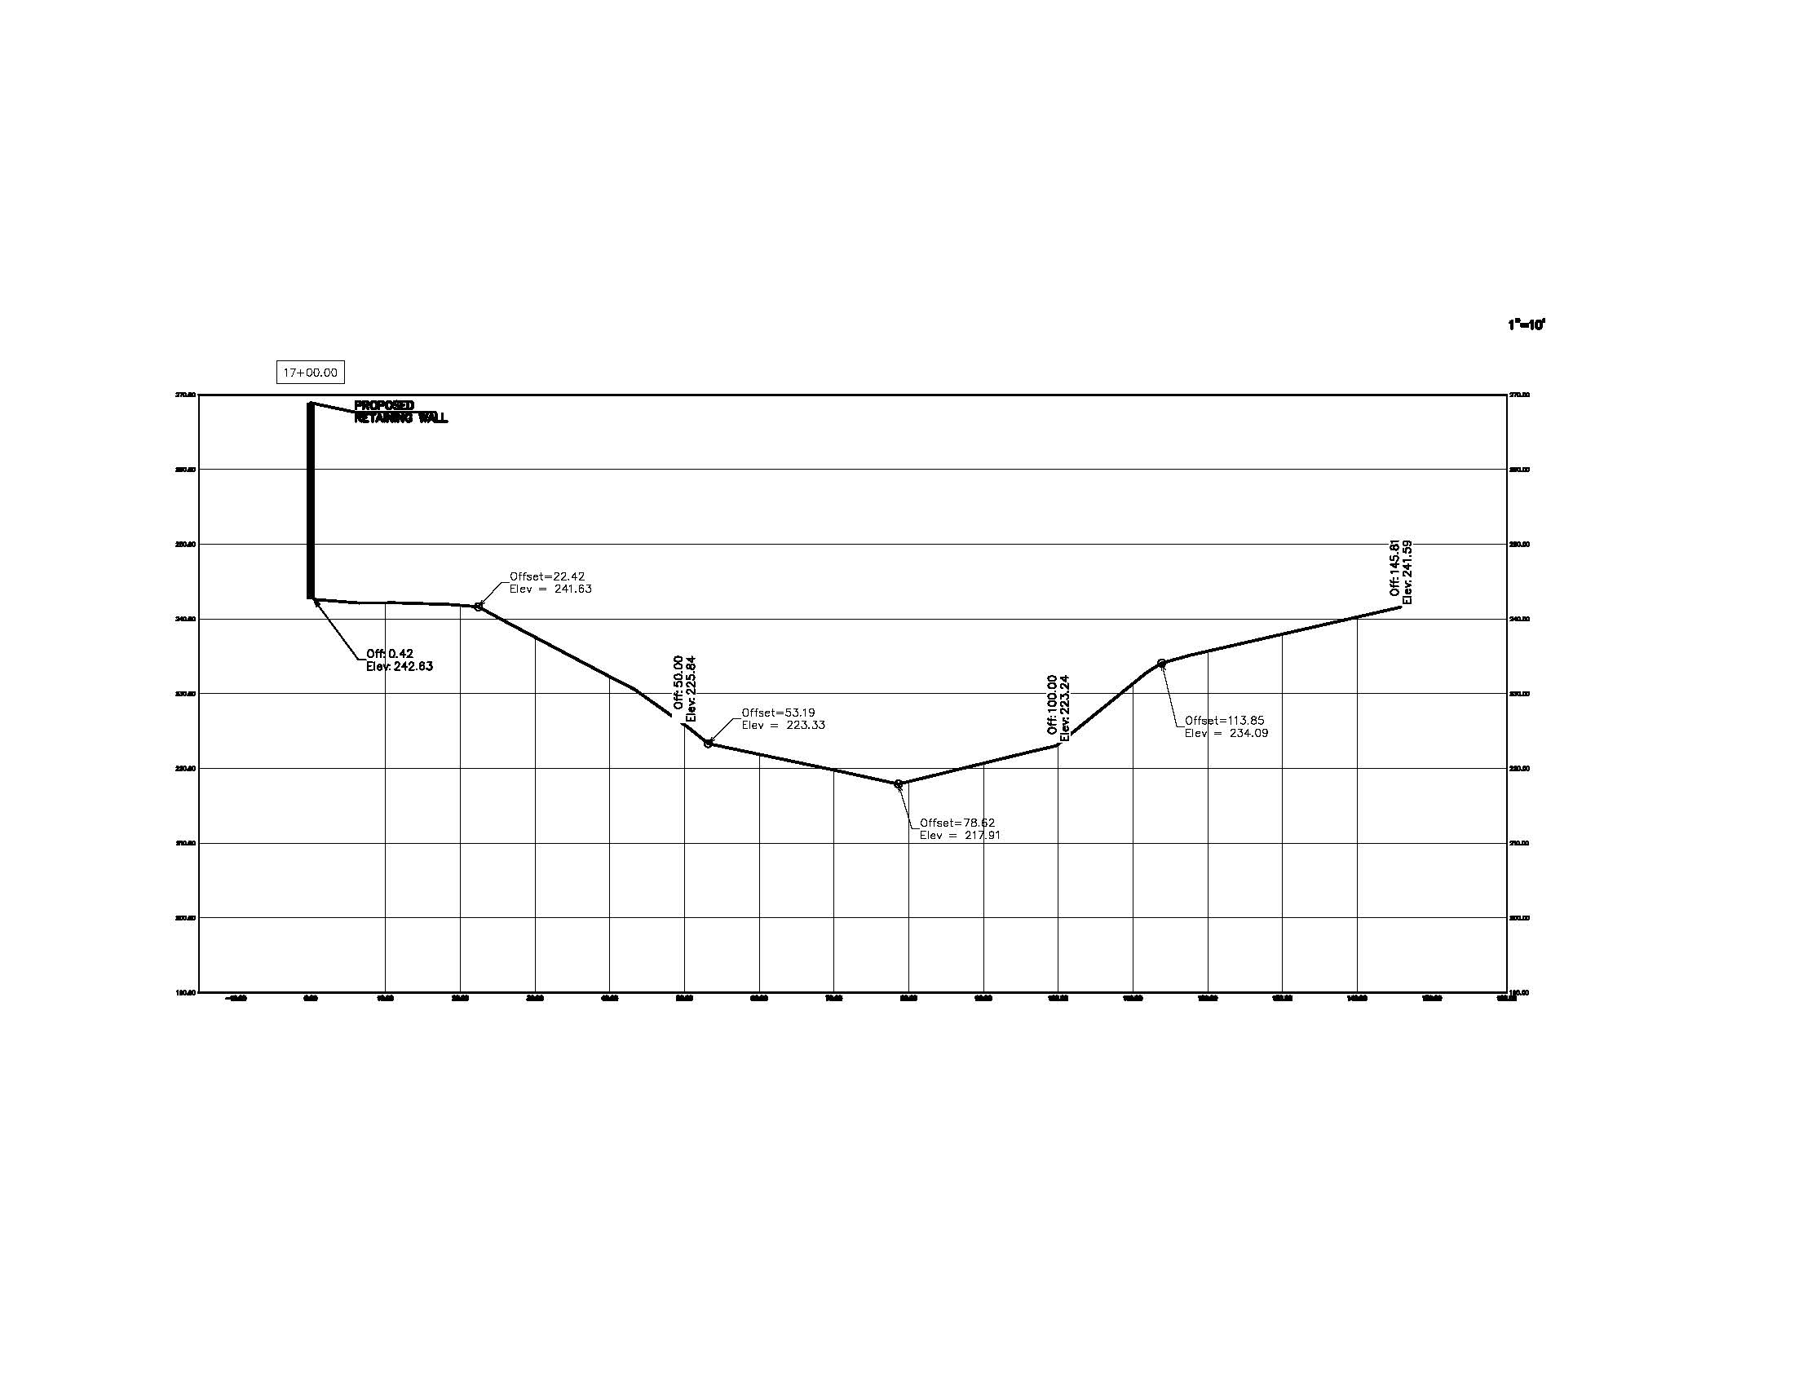
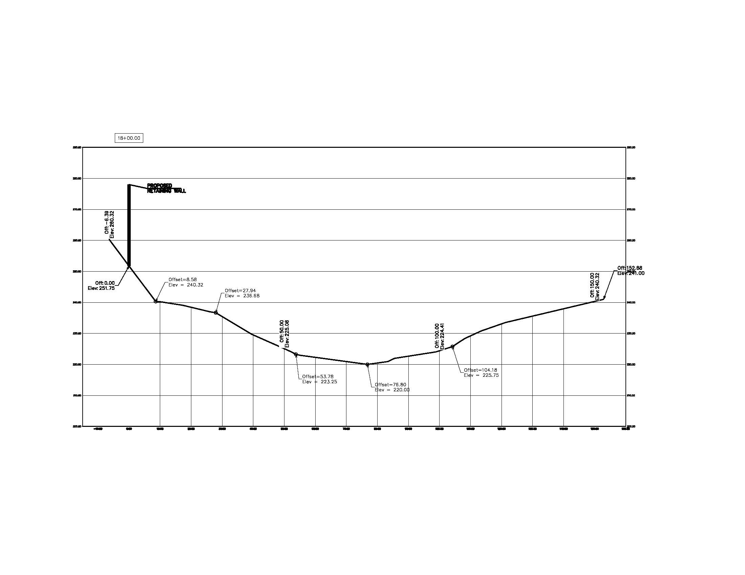
WALL 10 CHALLENGE

Slide 44
WALL 10 CHALLENGE cont.
Global stability minimum factors of safety have to be satisfied:
  1.30 static
  1.1 seismic
Initial design utilized soldier pile wall
Procedure:
  Determine the required force per pile (based on wall configuration and pile spacing) to achieve a FoS of 1.10
  Perform LPILE analysis (Chapter 10 Duncan & Wright) to determine min. shaft embedment below failure surface, bending moment and lateral deflection

Slide 45
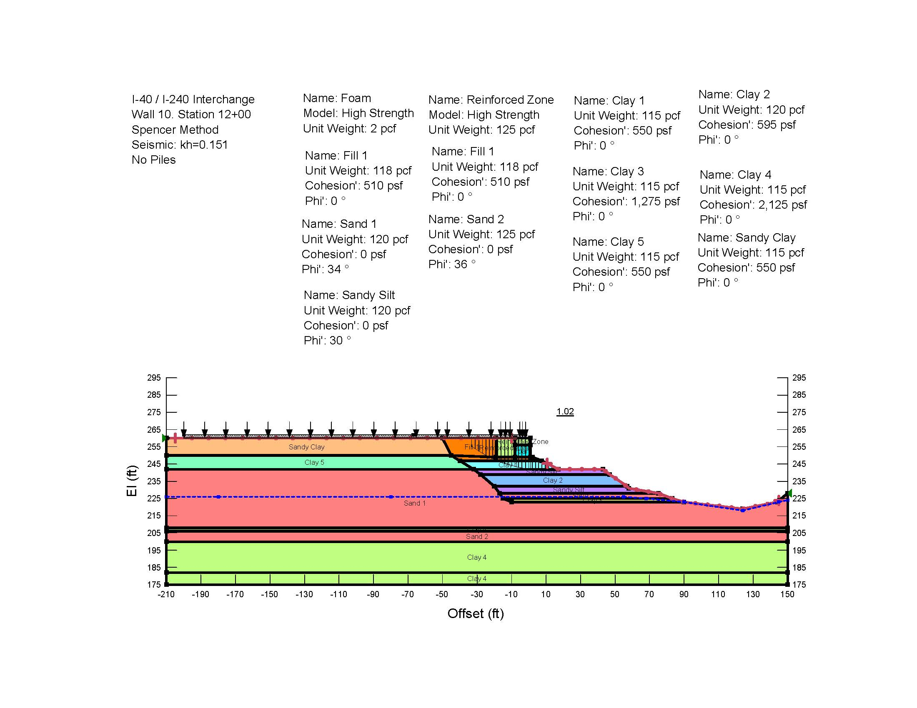
WALL 10

Slide 46
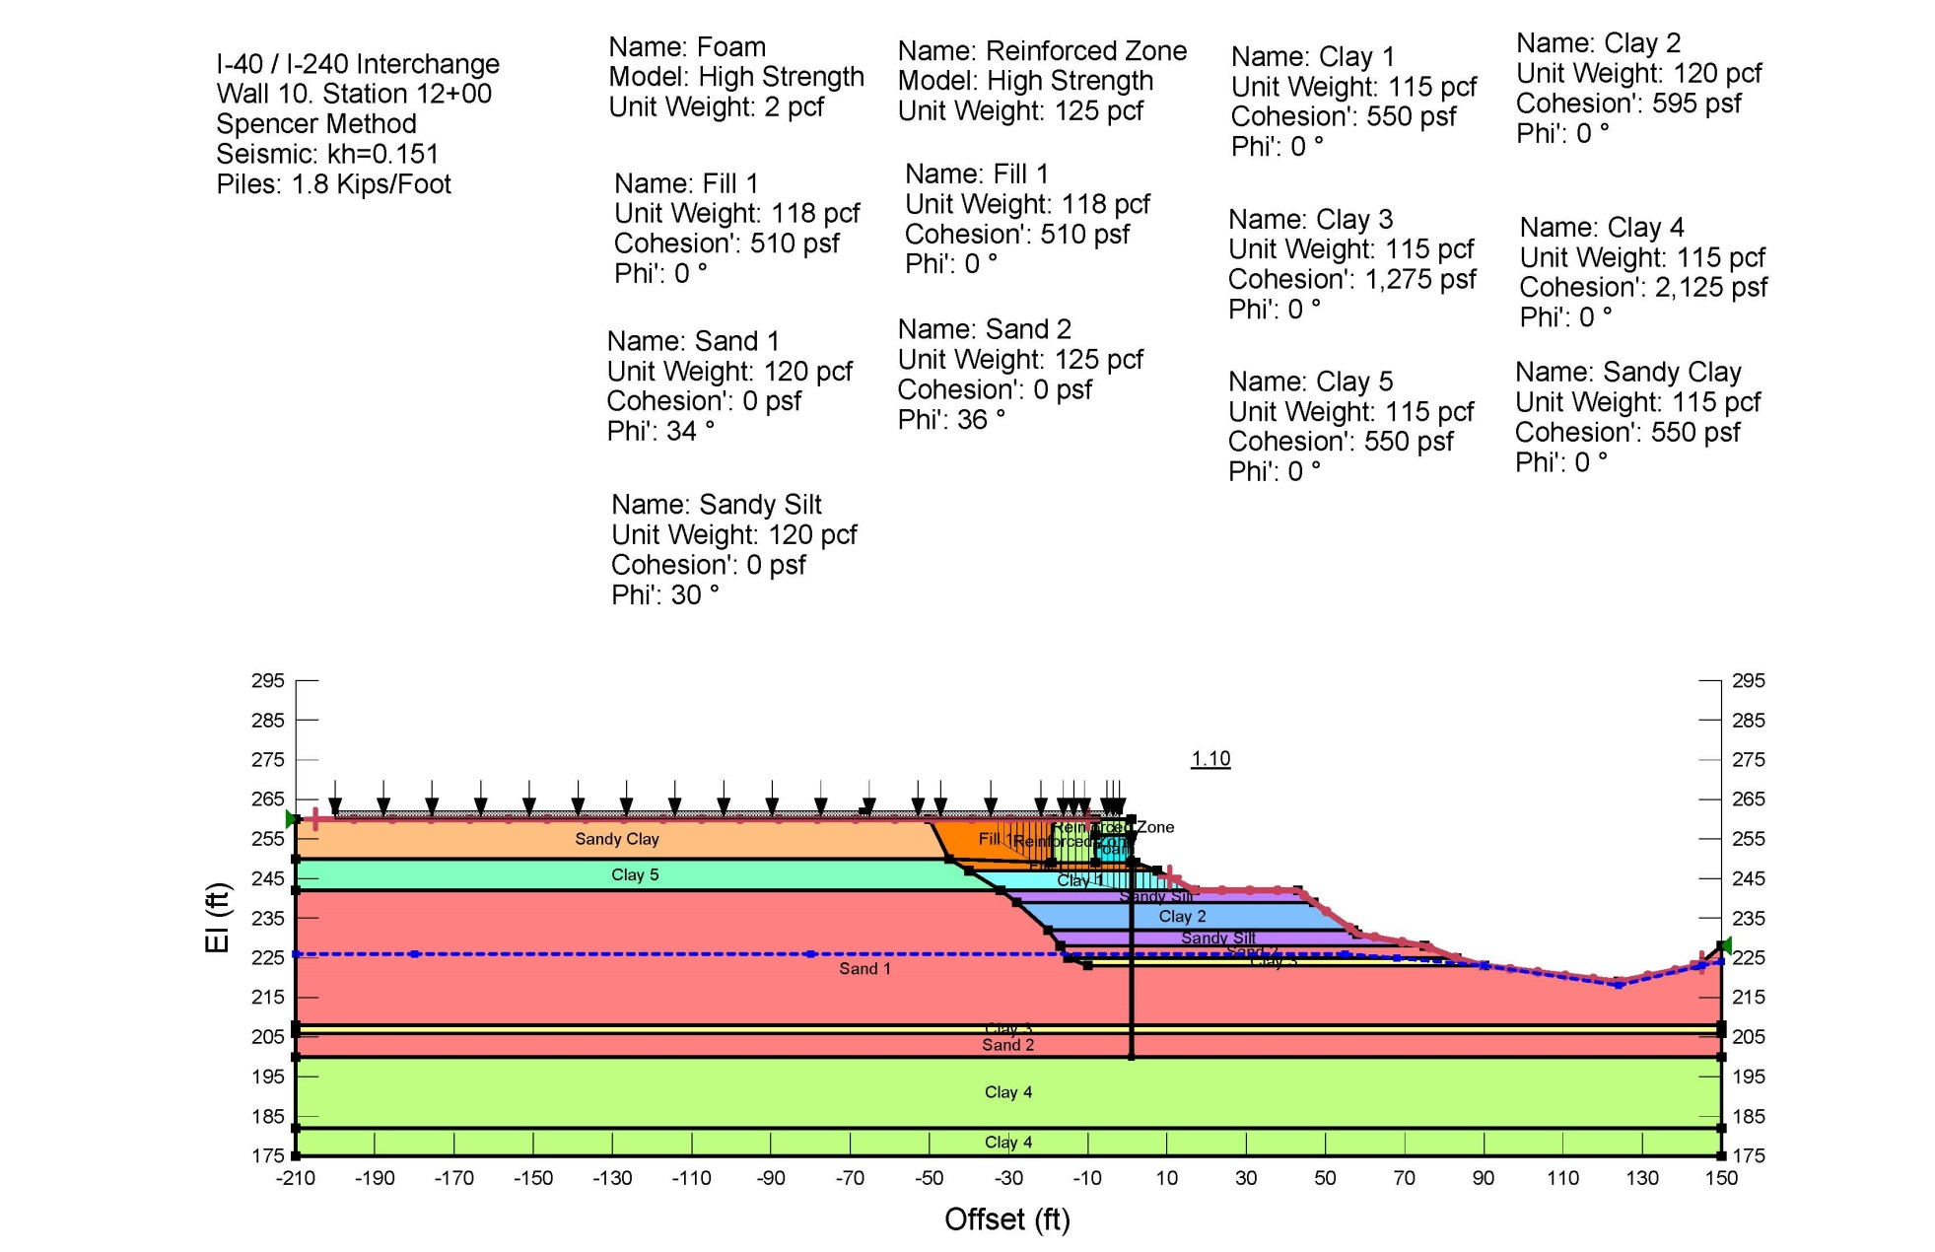
WALL 10

Slide 47
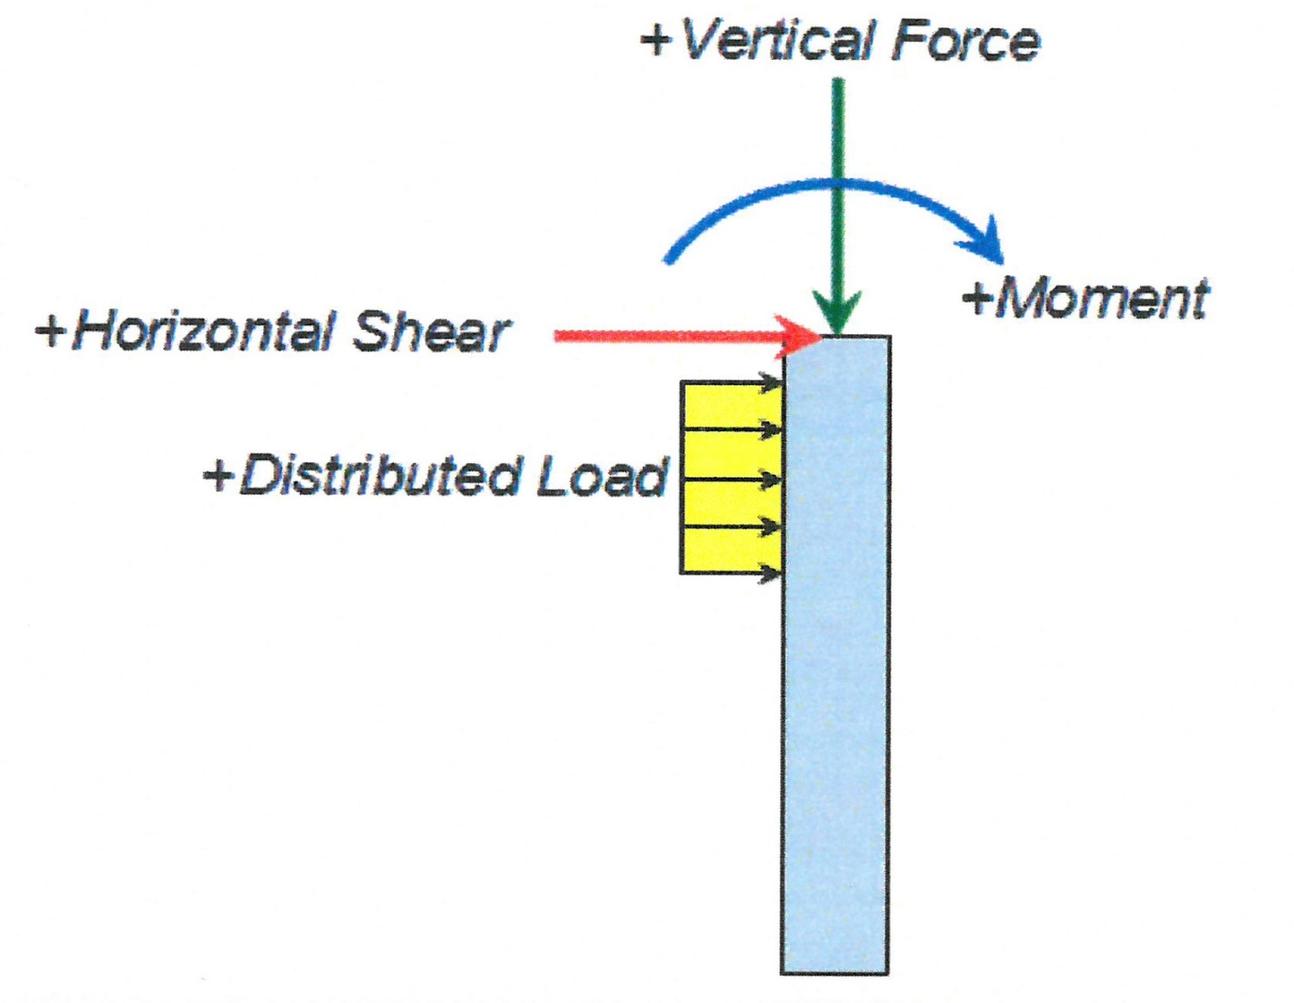
LPILE ANALYSIS
Location of Slip Surface

Slide 48
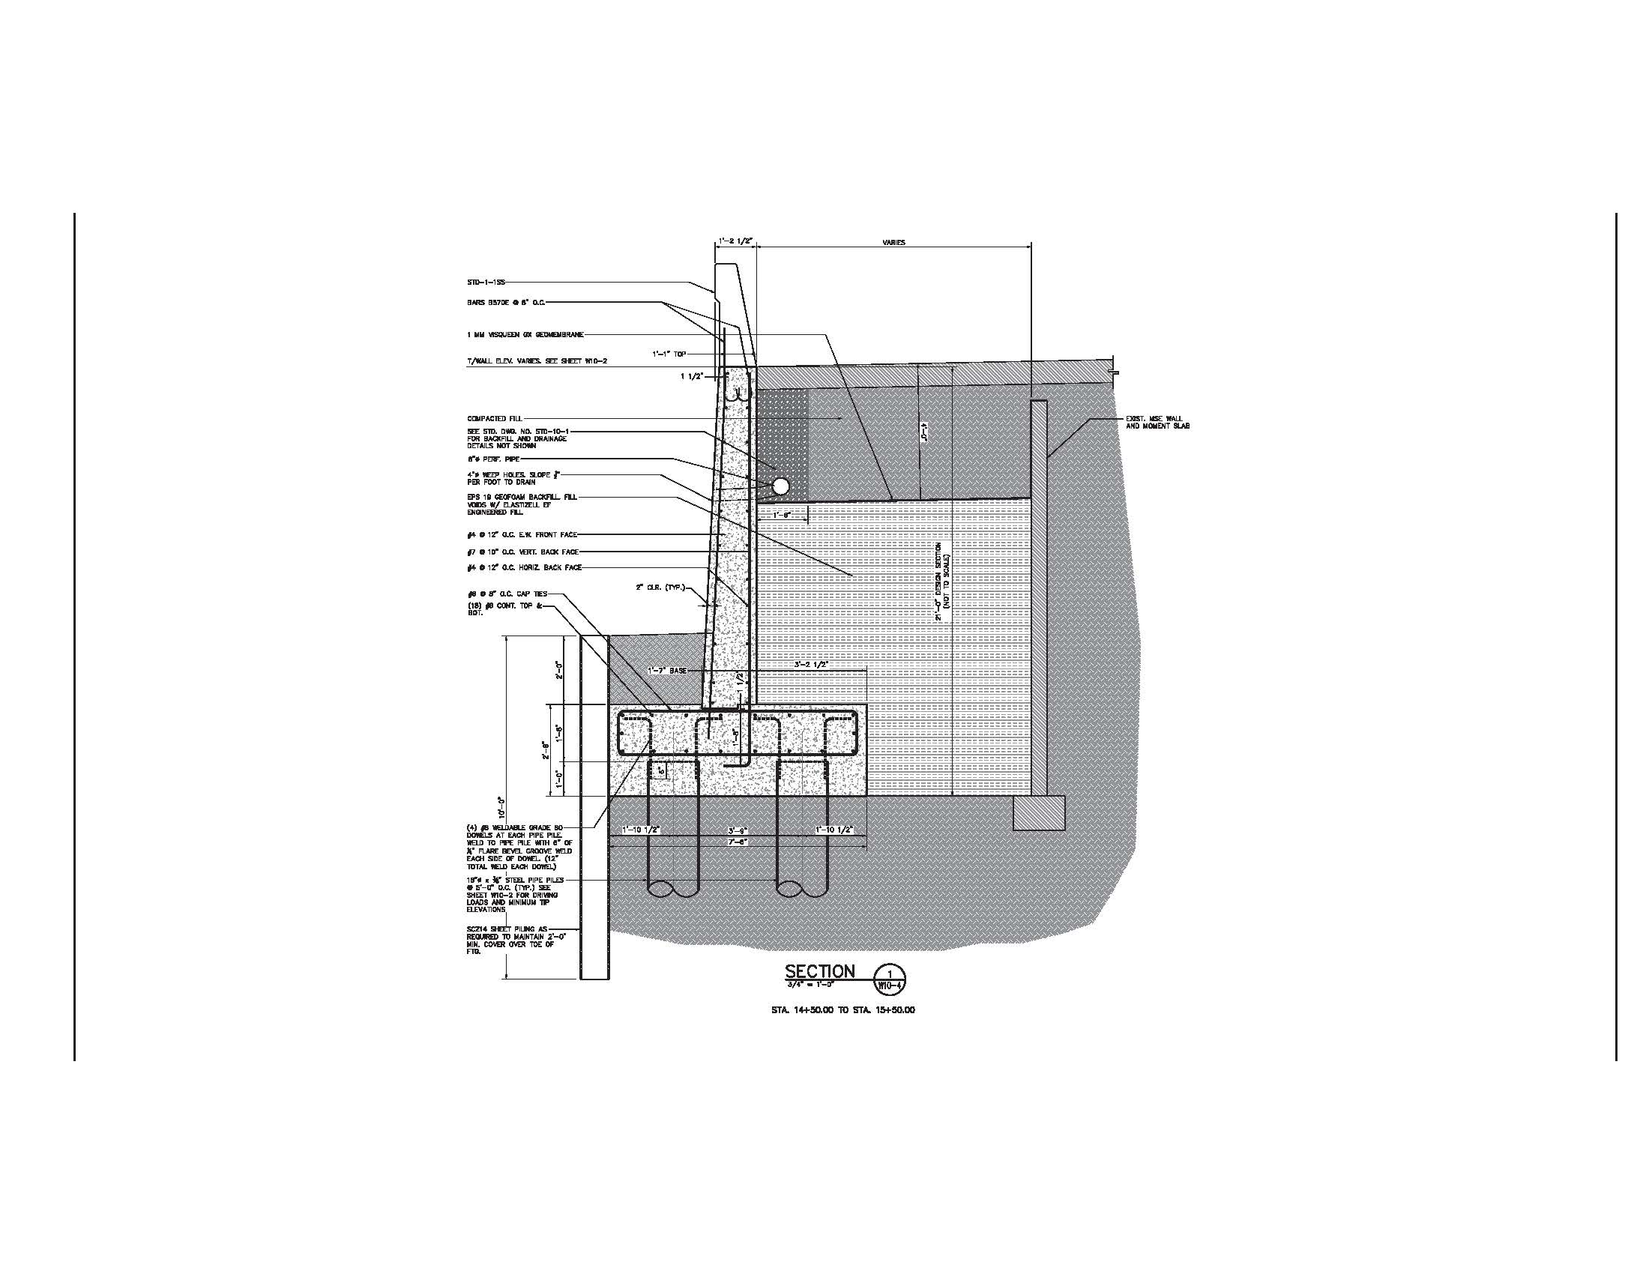
WALL 10
Geofoam
Two or three Pile Rows

Slide 49
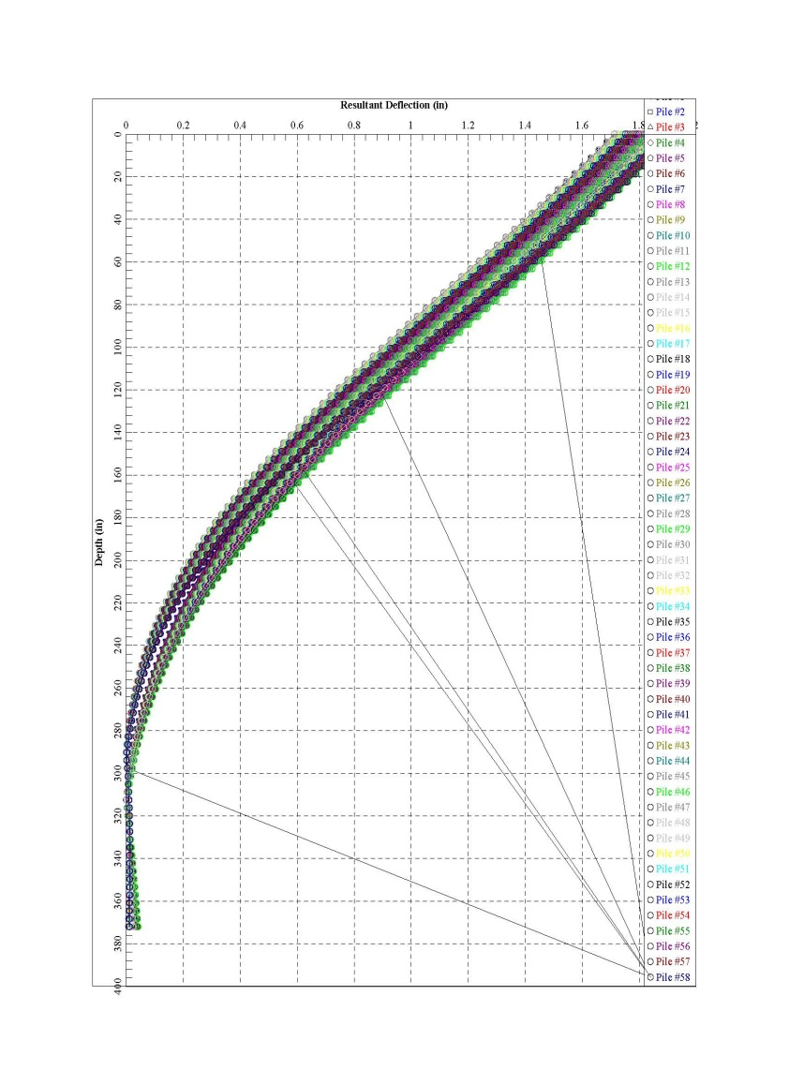
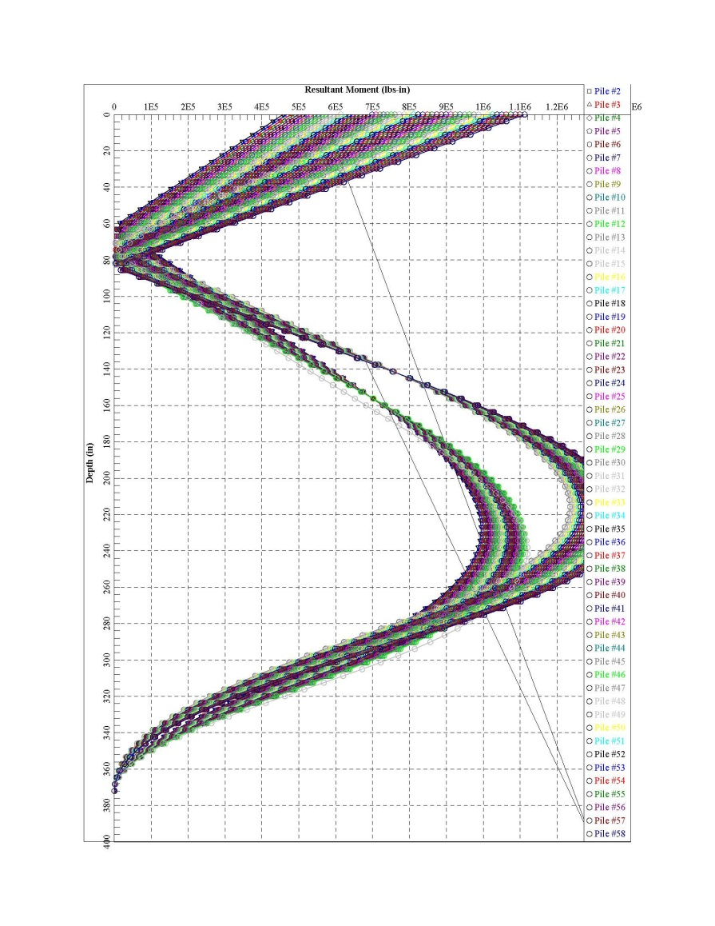
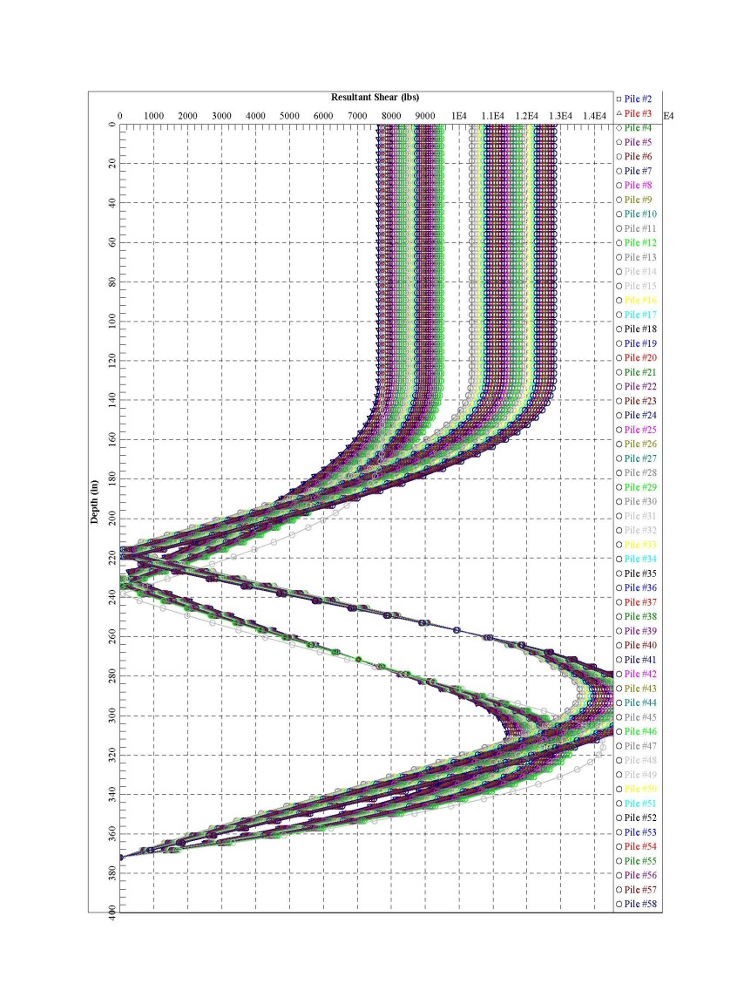
WALL 10 – GROUP ANALYSIS

Slide 50
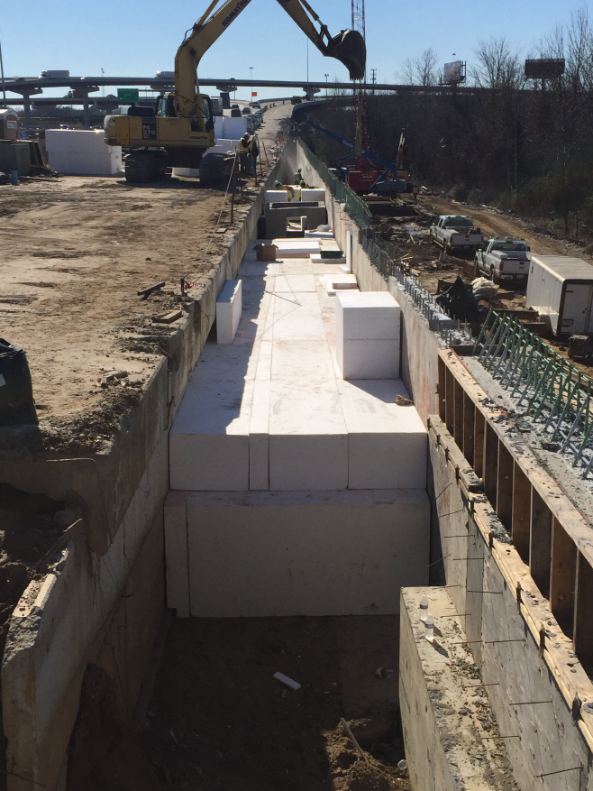
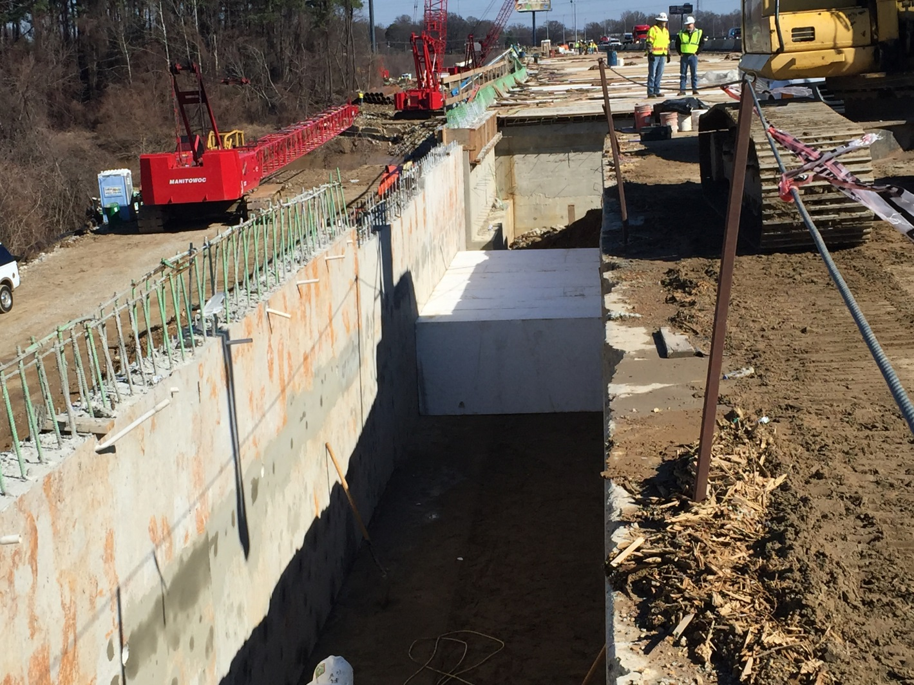
WALL 10 CONSTRUCTION

Slide 51
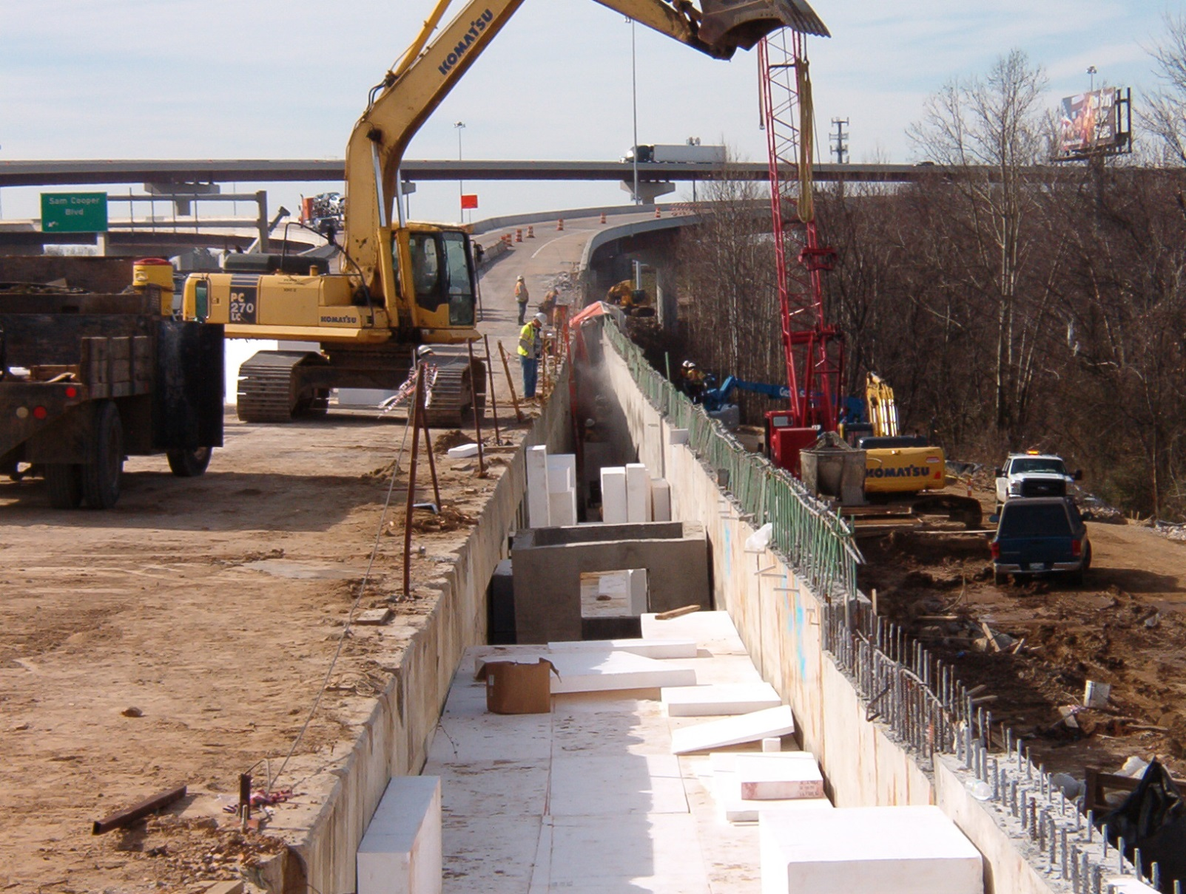

WALL 10 CONSTRUCTION

Slide 52


PROJECT PROGRESS (JUNE 2015)

Slide 53



Slide 54

BRIDGE 2

Slide 55

BRIDGE 1

Slide 56

PROJECT PROGRESS (August, 2016)

Slide 57


Slide 58


Slide 59



